Slide 1

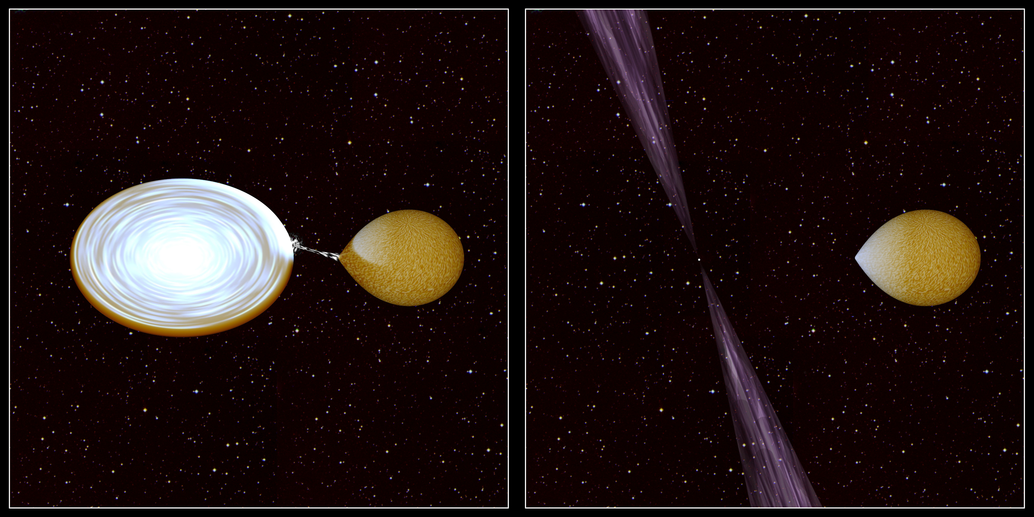
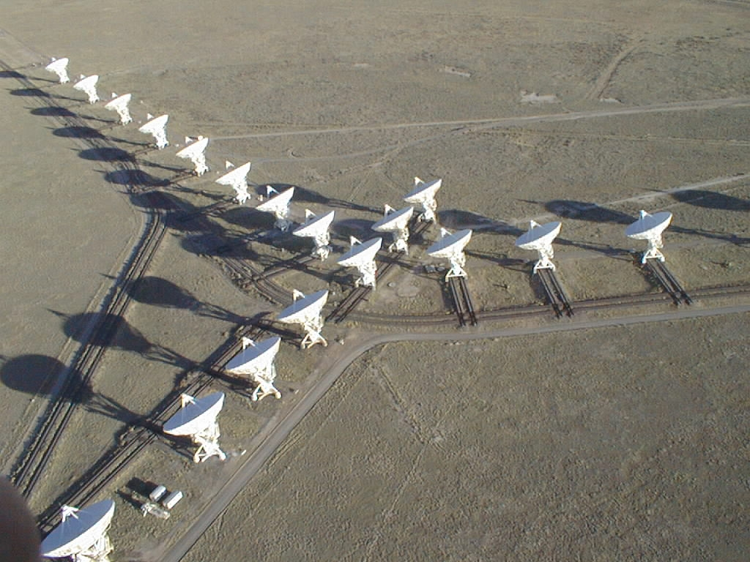

The radio/X-ray correlation in transitional MSPs
What makes tMSPs special amongst neutron star LMXBs?
Adam Deller
26/06/2015

Slide 2
With thanks to
Participants across many institutes:
  Anne Archibald, Jason Hessels, Javier Moldon, Gemma Janssen, Cees Bassa, George Heald, Nicolas Vilchez (ASTRON)
  James Miller-Jones (Curtin)
  Alessandro Patruno, Caroline D’Angelo (Leiden)
  Zsolt Paragi (JIVE)
  Slavko Bogdanov, Jules Halpern (Columbia)
  Vicky Kaspi (Macgill)
  Andrew Lyne, Ben Stappers, Benetga Perera (Manchester)
  Shriharsh Tendulkar (Caltech)
  Amruta Jaodand, Rudy Wijnands (Amsterdam)
For more details see:
  Deller et al. 2015, ApJ, accepted (arXiv: 1412.5155)
  Archibald et al. 2015, ApJ, accepted (arXiv: 1412.1306)
  Bogdanov et al. 2015, ApJ, 806, 148
Notes:
There have been a lot of people involved with this project, the people involved with the radio observations which I’m going to focus on today are highlighted in bold. And I’d like to also say particular thanks to Jason and Anne who provided some of the figures I’m using in this presentation.

Slide 3
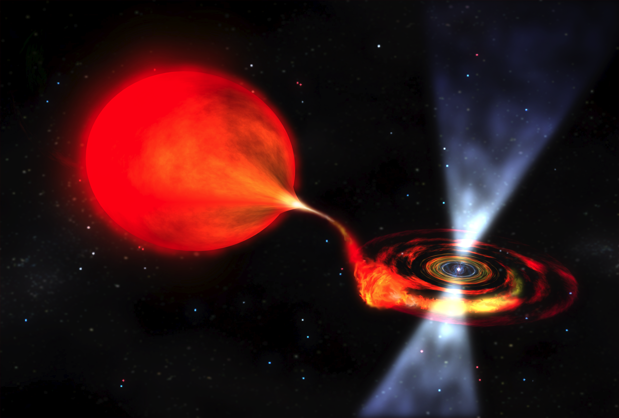
LMXB inputs and outputs
NASA, D. Berry
.
M_{jet}
.
.
M_{in}
M_{wind}
.
M_{obj.}
Notes:
I have about 7 minutes, so I’m going to keep it very simple and gloss over many of the complexities

Slide 4
LMXB energy budget
NASA, D. Berry
L_{jet}
L_{tot}
L_{wind}
L_{rad}
L_{obj.}
Notes:
In a simple picture, assume Lwind and Lobj are negligible. For a black hole system, Lobj can just be considered “gone” anyway (the unradiated energy is advected) and you could just subtract this off the input Ltot, since you’ll never see it. In the NS case, it will just contribute to Lrad since it has to be radiated when the particles hit the NS surface.

Slide 5
LMXB energy budget
NASA, D. Berry
L_{jet}
L_{tot}
L_{wind}
L_{rad}
L_{obj.}
Fender et al. (2001, 2003), Migliari et al. (2006)
Notes:
In a simple picture, assume Lwind and Lobj are negligible. For a black hole system, Lobj can just be considered “gone” anyway (the unradiated energy is advected) and you could just subtract this off the input Ltot, since you’ll never see it. In the NS case, it will just contribute to Lrad since it has to be radiated when the particles hit the NS surface.

Slide 6
LMXB observables
Radiated energy is dominated by
X-rays: L_{X} ~ L_{rad}
Jet luminosity can be estimated via radio: L_{R} ∝ L_{jet}^{1.4} ➔ L_{R} = A L_{jet}^{1.4}
What is seen for black hole LMXBs?
Notes:
A is extremely uncertain, needs a good estimate of Lj and this is hard to come by. Estimates span several orders of magnitude.

Slide 7
L_{R}/L_{X} correlation
L_{R} ∝ L_{X}^{0.61}
(Gallo et al., 2014)
Notes:
X-ray measurements taken with Swift, or XMM, Chandra etc; radio with VLA, ATCA, AMI… Individual sources show a tighter correlation than the overall (and you can see here that there are some excursions from the overall; the “faint track”)

Slide 8
L_{R}/L_{X} correlation
Simple models of radiatively inefficient accretion predict
L_{jet} ∝ M_{in}
L_{rad} ∝ M_{in}²
L_{jet} ∝ L_{rad}^{0.5}
L_{R} ∝ L_{X}^{0.7}
What about the neutron star systems?
.
.

Slide 9
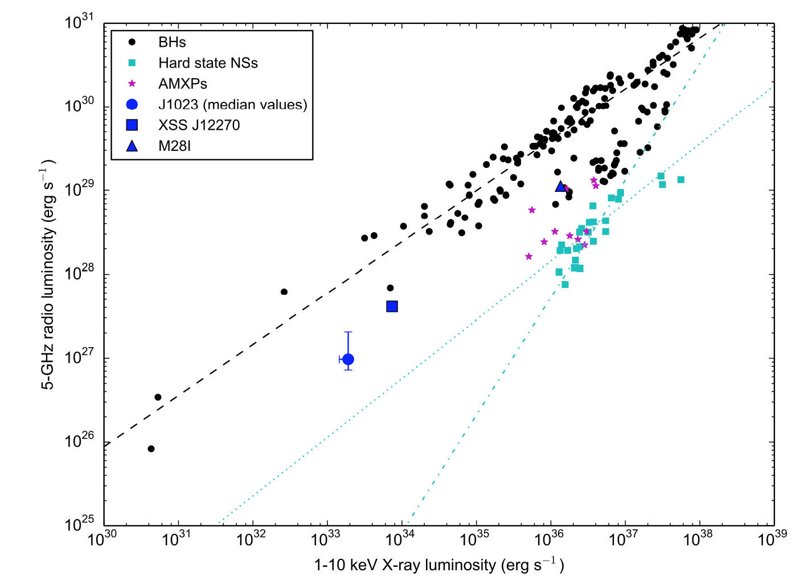
L_{R}/L_{X} correlation
Notes:
At a given X-ray luminosity, NS-LMXBs are 10-50x fainter than the BH-LMXBs in the radio. That implies that, all other things being equal (like the conversion efficiency from Jet to Radio, which there are no constraints for in the NS systems), the jets are ~10x less luminous in the NS systems. Note that unlike the BH systems, the correlation for NS systems have almost never been measured for a single source, so these are two fairly wild guesses at possible correlations here.

Slide 10
L_{R}/L_{X} correlation
(At least) two potential relations for the NS-LMXBs:
L_{R} ∝ L_{X}^{0.7} (like BH systems, but less radio-loud [weaker jets]); or
L_{R} ∝ L_{X}^{1.4} (L_{jet} ∝ M_{in}, L_{rad} ∝ M_{in} : fixed fractions going to jet / radiated)
What about the transitional MSPs?
.
.

Slide 11
L_{R}/L_{X} correlation
Notes:
tMSPs are much more radio bright than predicted by either relation from the hard state NS-LMXBs! Just 5x fainter in radio that BHs, = 3x less energetic jet. This is what we can say with confidence. Then we want to answer the question: why? And what inferences can we draw? From hereon, we enter the realms of increasing speculation. If you want, you can draw a correlation through these three points with an index of 0.7 (or 0.61) and it fits very suggestively. Now, of course none of these sources have an individual correlation index, so how valid is it to draw this? I don’t know. But certainly they are all radio over-luminous. Question: are all tMSPs like this? Are all NSs accreting below 10^36 erg/s like this?

Slide 12
L_{R}/L_{X} correlation
3FGL J1544
1RXS J1804
Notes:
That is where we were at at the beginning of this year, after wrapping up the work on J1023. Since then…

Slide 13
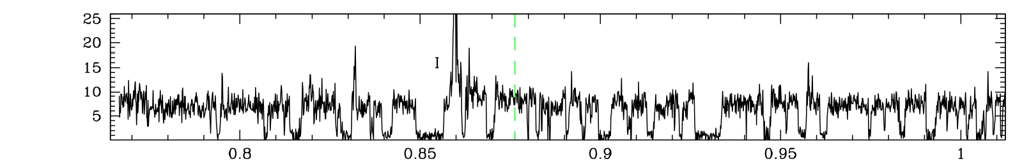
Conclusions, open questions
J1023 shows a radio emission from a compact jet in the LMXB state
All the known and suspected tMSPs are radio over-luminous compared to other NS-LMXBs
  Propeller mechanism -> efficient jet formation? Connection to gamma-rays?
  In what mode(s) is this efficient jet formation occurring?

Slide 14
J1023 LMXB state: radio
Deller14+
Notes:
All that was looking at what is going on in the disk. What about the outflowing material? Is there any? Well, the answer from the radio is YES.

Slide 15
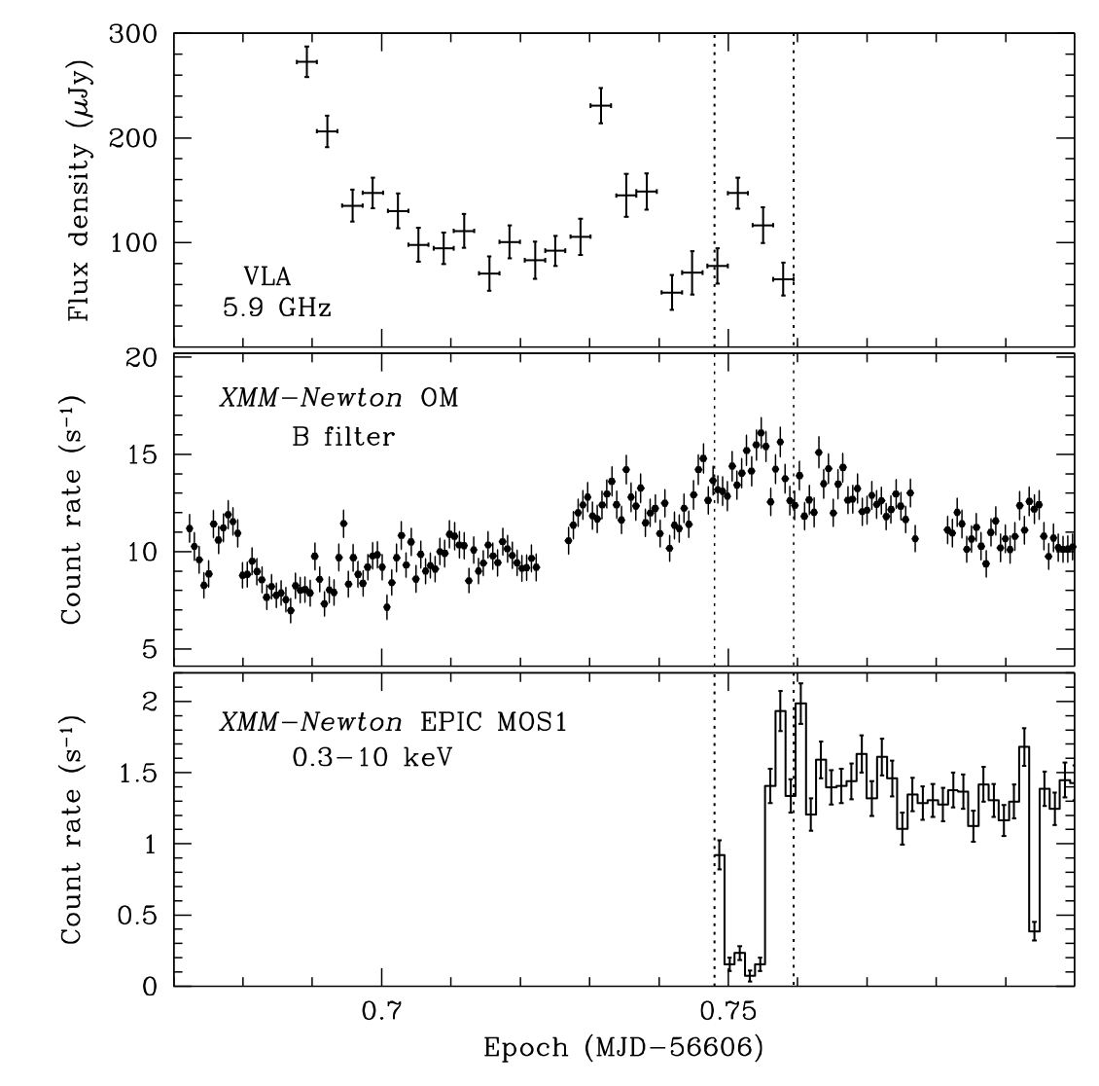
J1023 LMXB state: radio
Limited overlap
with X-ray:
not possible
to determine
if correlation
present; no
sign of steep
spectrum pulsar
emission
(Bogdanov14+)

Slide 16
J1023 LMXB state: monitoring

Slide 17
J1023 LMXB state: monitoring
Second XMM-Newton observation in June 2014
showed identical X-ray behaviour, as did Swift monitoring
Consistent
with “high”
mode seen
in detail by
XMM

