Slide 1
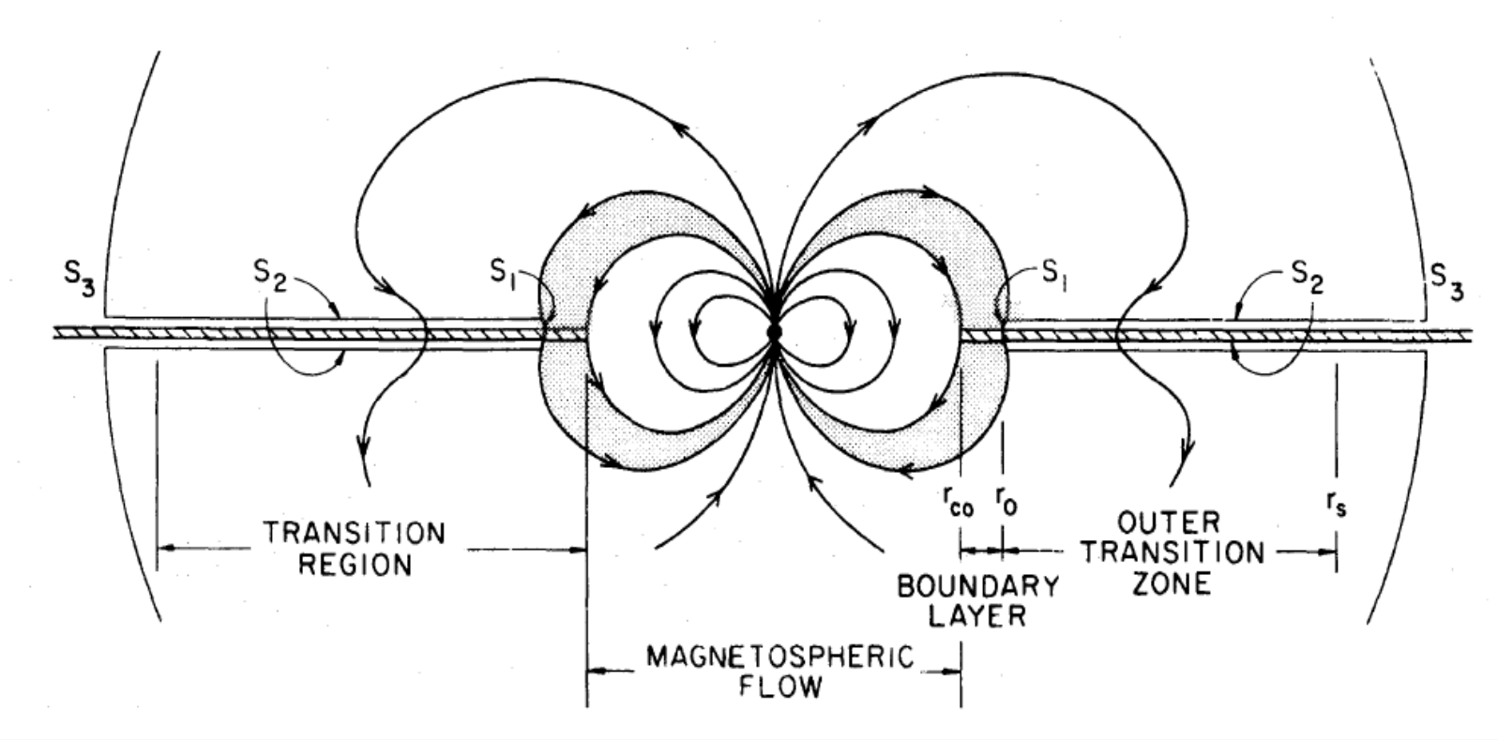
On the low level x-ray emission of transitional pulsars
Enrico Bozzo
University of Geneva

Slide 2
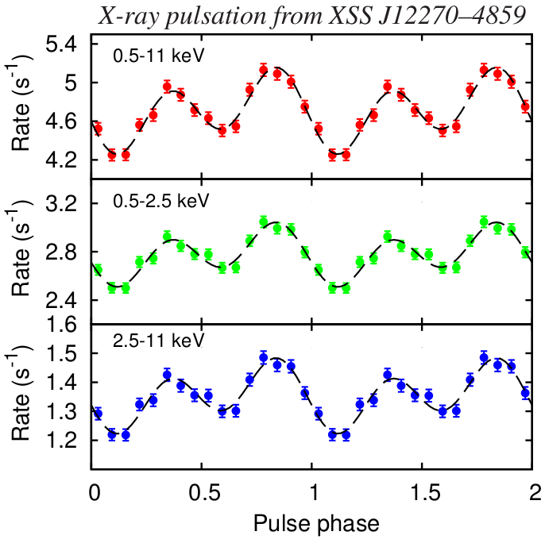
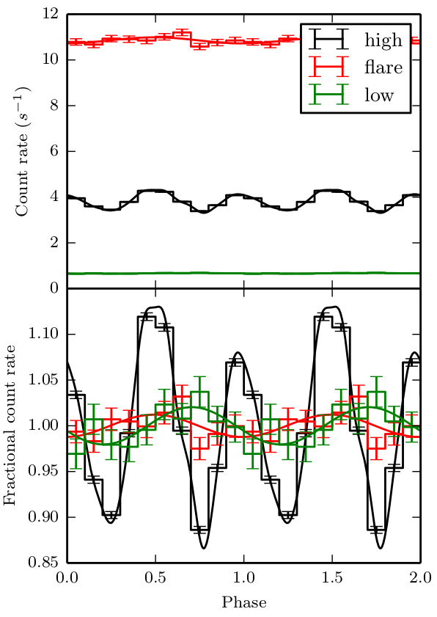
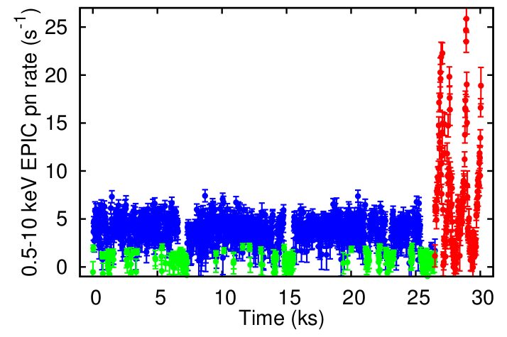
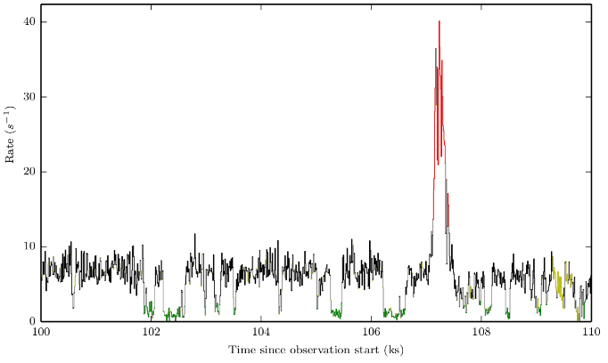
Transitional pulsars pulsations at unprecedentedly low X-ray Luminosities
XSS 12270-4859
P_{spin} = 1.69 ms
L_{X} = 5x10³³ erg/s
(Papitto et al. 2015)
PSR J1023+0038
P_{spin} = 1.69 ms
L_{X} = 3x10³³ erg/s
(Archibald et al. 2014)

Slide 3
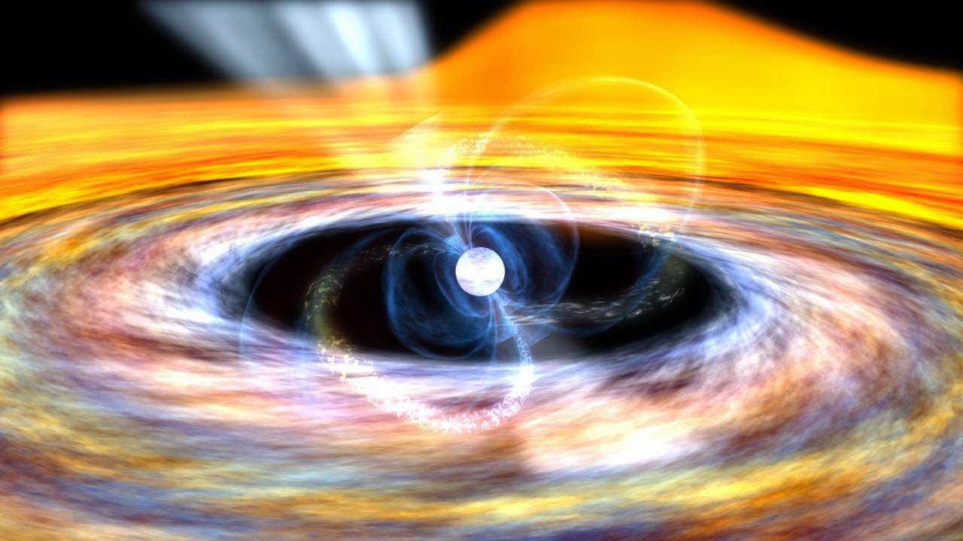
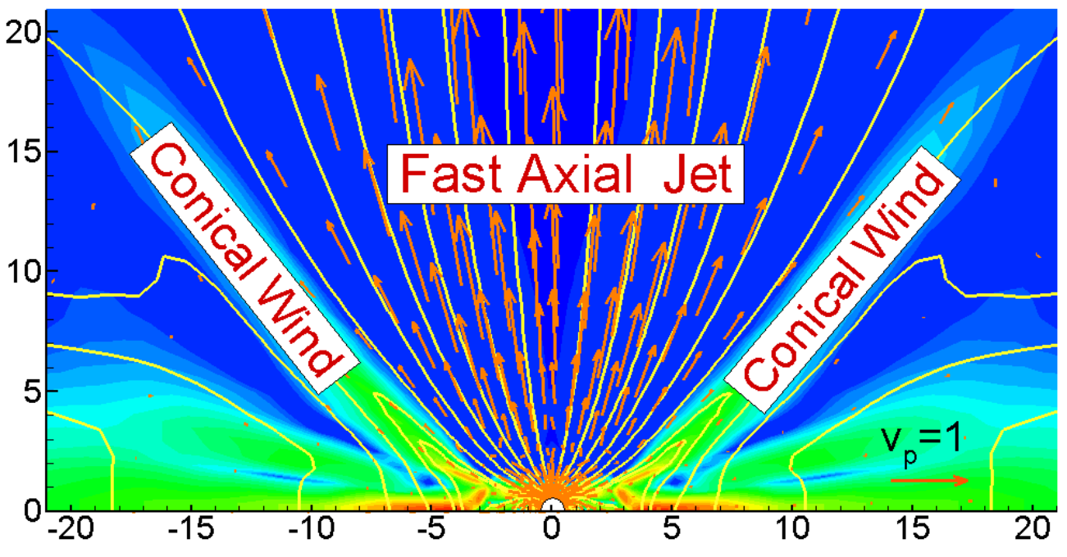

Transitional pulsars pulsations at unprecedentedly low X-ray Luminosities
(Romanova et al. 2014)
R_{M}
Accretion proceeds as long as the magnetospheric radius is smaller than the corotation radius
In the propeller regime, the rapidly rotating neutron star generates powerful outflows
R_{M} < R_{C} → Accretion
R_{M} > R_{C} → Propeller effect (ejection)
Ω_{K} = Ω_{S} →
R_{M} ?

Slide 4
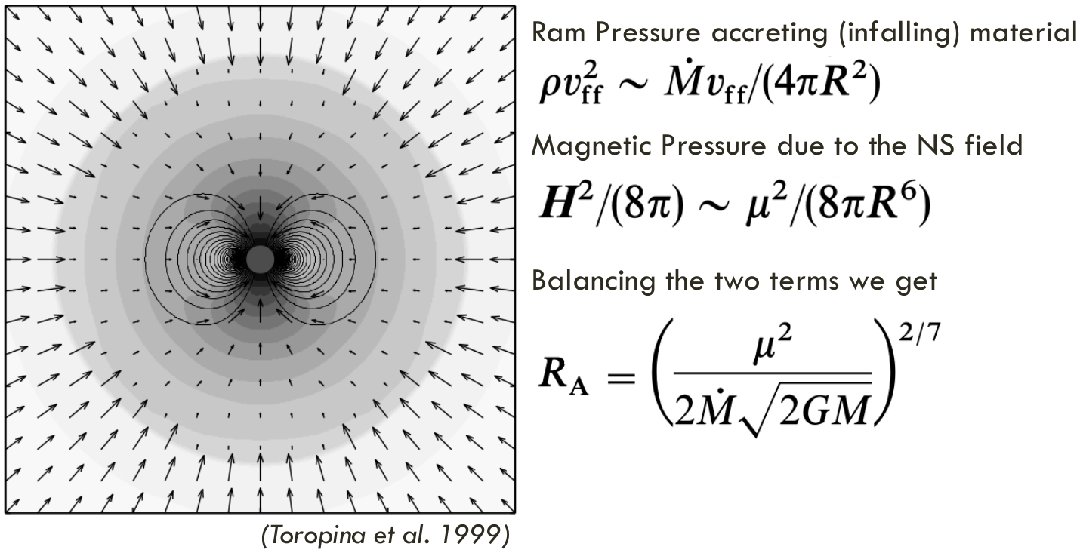

Transitional pulsars pulsations at unprecedentedly low X-ray Luminosities
The simplest ‘spherical’ approximation

Slide 5
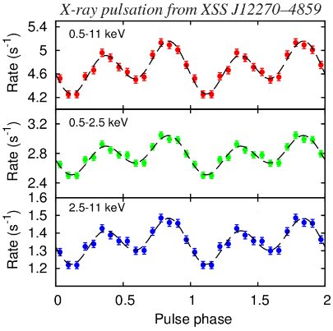
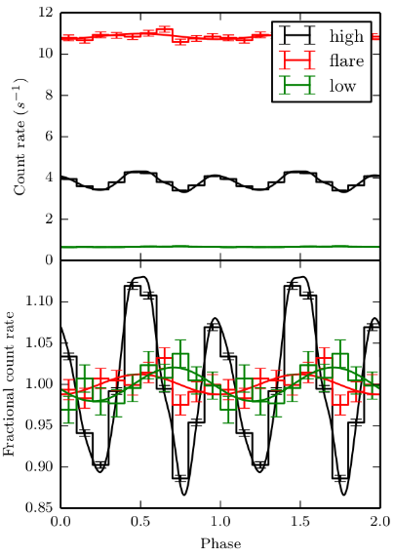


Transitional pulsars pulsations at unprecedentedly low X-ray Luminosities
XSS 12270-4859
P_{spin} = 1.69 ms
L_{X} = 5x10³³ erg/s
(Papitto et al. 2015)
Accretion only if:
PSR J1023+0038
P_{spin} = 1.69 ms
L_{X} = 3x10³³ erg/s
(Archibald et al. 2014)
But the resulting X-ray luminosity would be orders of magnitudes above the observed one

Slide 6

Two possible solutions: outflows
Unrealistically large outflows:
About 99.8 % of the material arriving at R_{M} shall be ejected by powerful outflows to get
(Romanova et al. 2014)
Radio observations support the idea of strong outflows in these systems, but from numerical simulations the strongest ejections reach ~70-80 % (Lii et al. 2014)

Slide 7

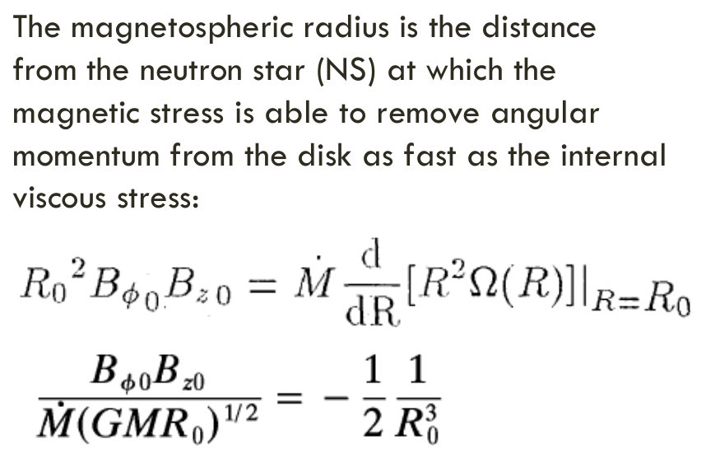
Two possible solutions: location of r_{m}
Beyond the spherical approximation: magnetically threaded disk models (Ghosh & Lamb 1978-9)

Slide 8
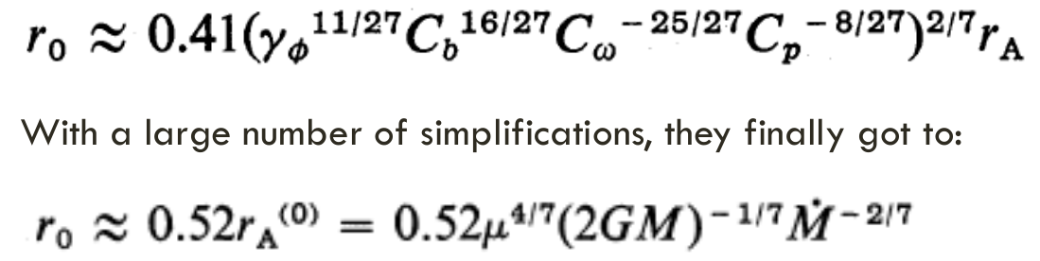
Two possible solutions: location of r_{m}
Beyond the spherical approximation: magnetically threaded disk models (Ghosh & Lamb 1978)

Slide 9
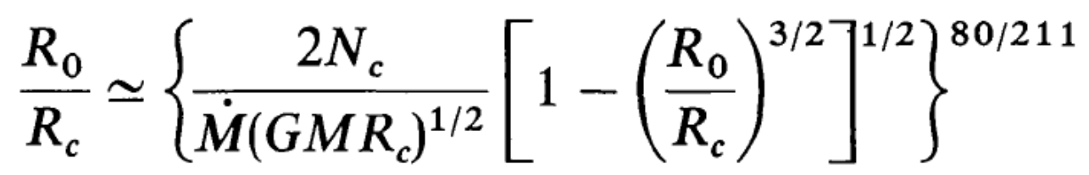
Two possible solutions: location of r_{m}
Beyond the spherical approximation: the Wang model
(Wang 1981, 1987, 1995, 1997)

Slide 10
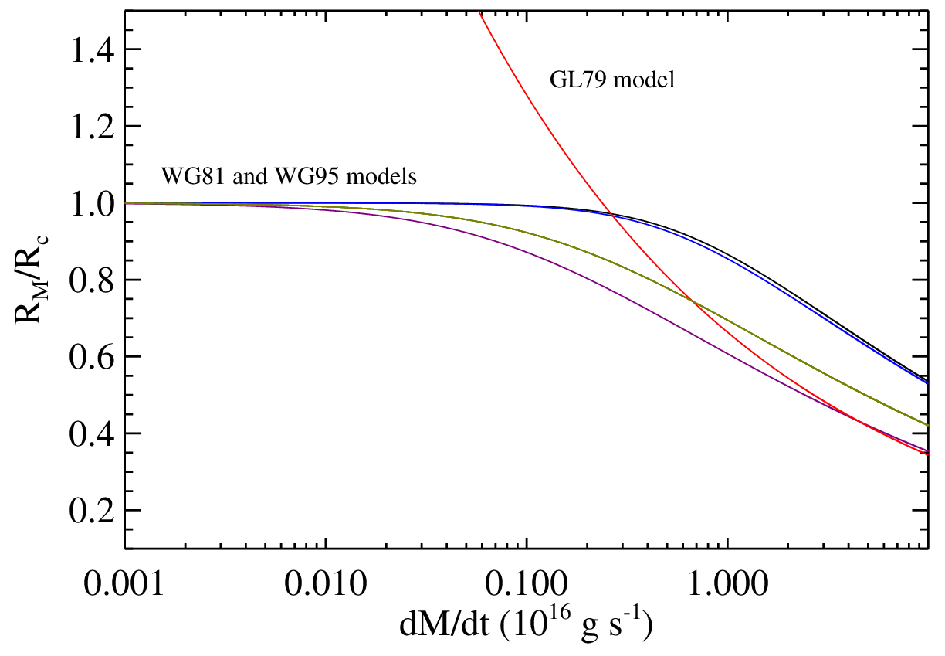
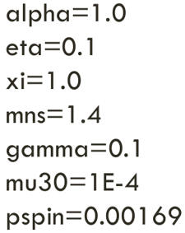
Two possible solutions: location of r_{m}
Comparing Wang and Ghosh & Lamb prescriptions for the magnetospheric radius
(Bozzo 2009)

Slide 11
Two possible solutions: location of r_{m}
Comparing Wang and Ghosh & Lamb prescriptions for the magnetospheric radius
(Bozzo 2009)
Assuming R_{M}~0.9 R_{C}
More reasonable outflows could allow pulsations
Ejected mass: ~80-90%
Closer to expected values from numerical simulations
(compared to the previous 99.8%)
Mass accretion rate corresponding to the X-ray luminosity of the low activity states in transitional pulsars
(Bozzo et al. in prep.)

Slide 12
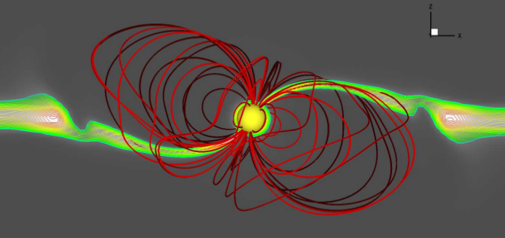
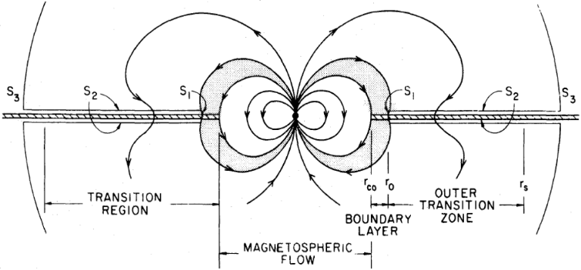

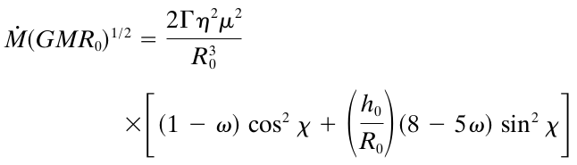
Two possible solutions: location of r_{m}
The inclined dipole case
(Wang1997)
χ
χ is the inclination angle between the rotation and magnetic axis of the neutron star

Slide 13
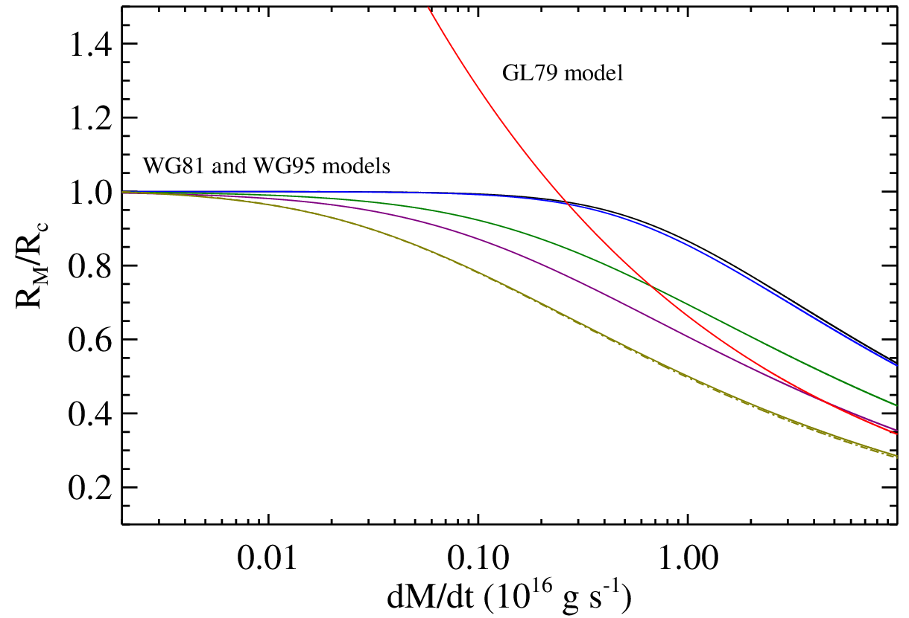
Two possible solutions: location of r_{m}
The inclined dipole case
(Wang1997)
Assuming R_{M}~0.9 R_{C}
Ejected mass: ~60-70%
χ = 60°
Mass accretion rate corresponding to the X-ray luminosity of the low activity states in transitional pulsars
(Bozzo et al. in prep.)

Slide 14
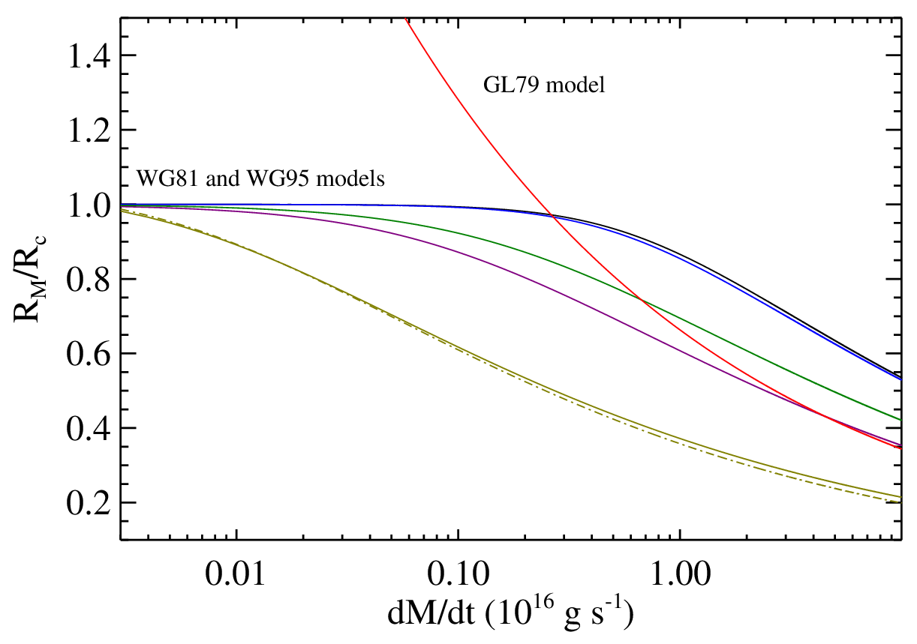
Two possible solutions: location of r_{m}
The inclined dipole case
(Wang1997)
Assuming R_{M}~0.9 R_{C}
More reasonable outflows could allow pulsations
Ejected mass: ~20-30%
Closer to expected values from numerical simulations
(compared to the previous 99.8%)
χ = 80°
Mass accretion rate corresponding to the X-ray luminosity of the low activity states in transitional pulsars
(Bozzo et al. in prep.)

Slide 15
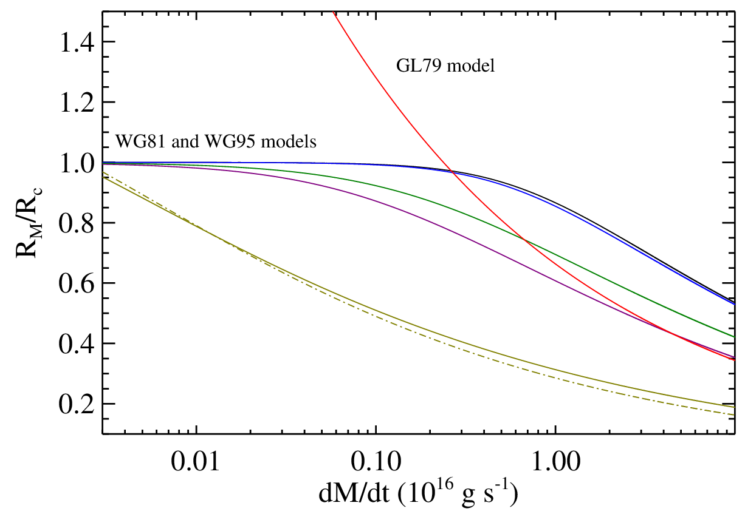
Two possible solutions: location of r_{m}
The inclined dipole case
(Wang1997)
Assuming R_{M}~0.9 R_{C}
Ejection not required
χ = 89°
(Bozzo et al. in prep.)

Slide 16
Conclusions
Sometimes it is said that the magnetospheric radius within different approximations is always consistent within a factor of 2-3
In neutron star LMXBs (and transitional pulsars) that is an enormous uncertainty:
  R_{C} ~ 2x10⁶ cm (corotation radius)
  R_{CL} ~ 5 x 10⁶ cm (light cylinder radius)
Different theories predict very different behaviors for the dependence of the magnetospheric radius from the mass accretion rate, especially when the ‘propeller’ regime is supposed to sets in (R_{M} ≈ R_{C})

Slide 17
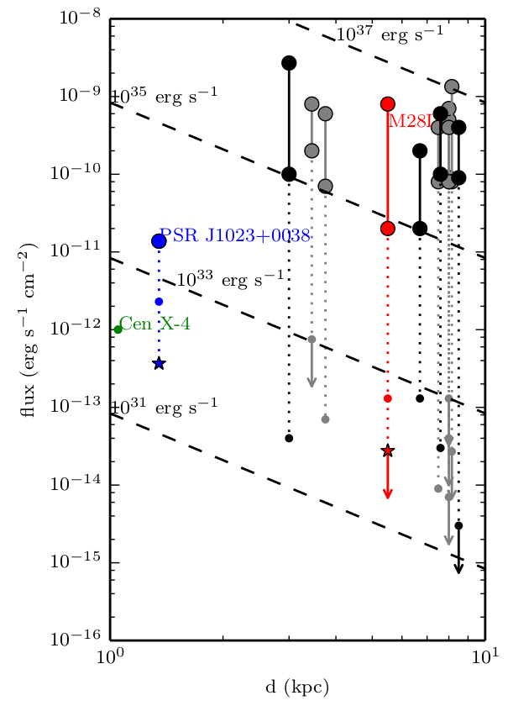
Conclusions
It is possible that transitional pulsars are neutron star LMXBs with a particularly high inclination angle between the spin and magnetic field axis - supported also from observations: θ>60° (De Martino 2014; Papitto 2014)
We cannot exclude that most of the accreting millisecond X-ray pulsars display pulsations at ~10³³ erg/s (but detections are hampered by the low statistics due to the larger distance).
(Archibald 2014)

