Slide 1
Shrouded Pulsars Winds & Masses
Renaissance due to Fermi evaporating PSR discoveries
  many wind-driving Fermi MSP – Roberts ‘11
  Clearly, radio selection effect biased previous sample
    Radio plane survey P_{B} bias to long periods, weak winds
    GC evaporating binary MSP – repeated visits, long dwells
    Now PSC: repeated obs of LAT sources → intermitent MSP
Pulling aside the veil of the shrouded systems
  Esp. MSP still buried in LAT UNIDed sources
  Probes of binary evolution, Neutron star physics

Slide 2
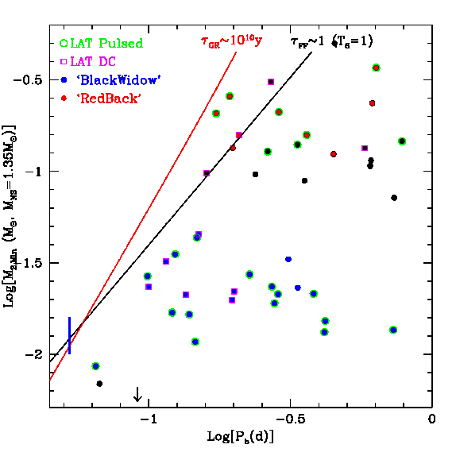
Shrouding and the LAT
Short Period Galactic Plane Binary MSP
  Lorimer list
Radio selection effects
  Absorption
  Scattering
  DM
Gamma-ray sources at the radio detection frontier
To dig even deeper -- Unidentified LAT sources

Slide 3
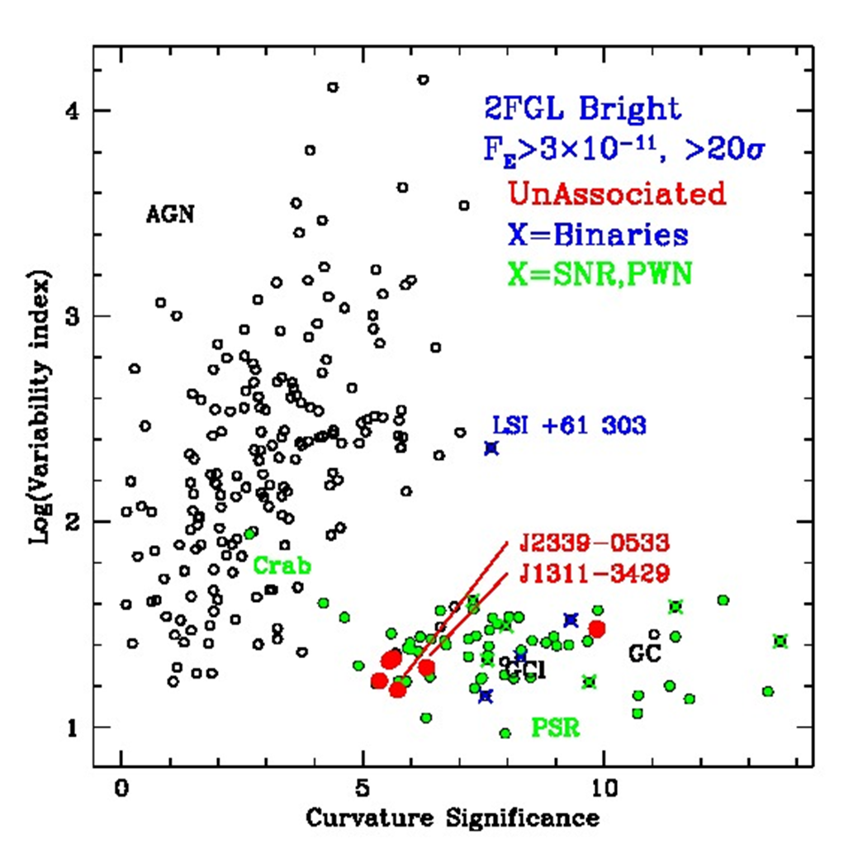
The Bright γ-ray Sources
Known about these for over 5 years (0FGL)
Bright, well measured, well searched
Most are Blazars (AGN)
Some are Pulsars or their ilk (PSR)
6 Remained UNIDed
UNIDed
Color – “Greeness”
“Fermi ‘s Missing Half Dozen”

Slide 4
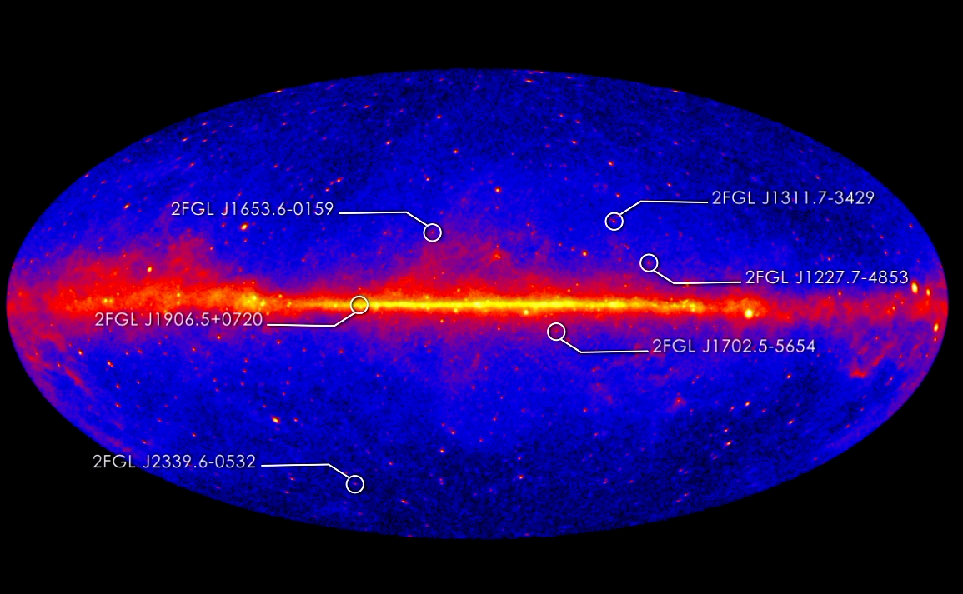
The Missing Half Dozen

Slide 5
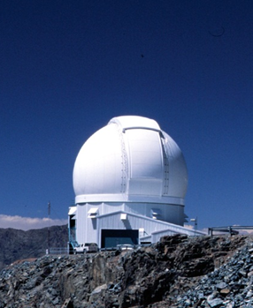
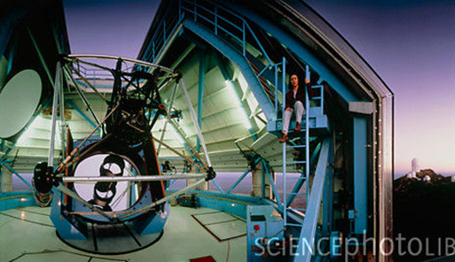
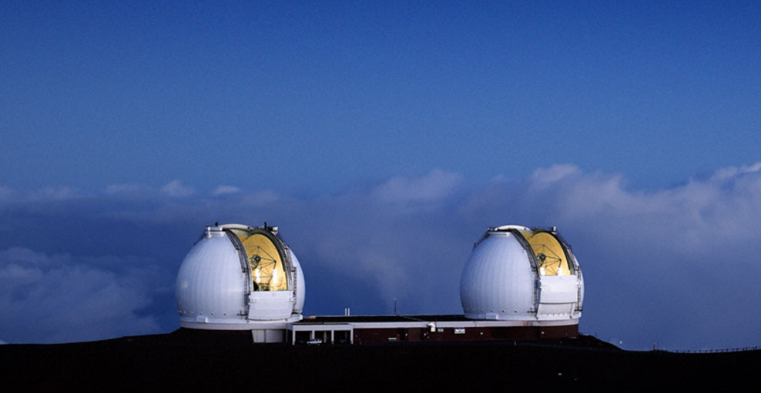
Identification Techniques
Image UNIDed error ellipses for heated optical companions.
  SWIFT/CXO/XMM helps narrow candidates
  Colors (WIYN,SOAR...)→large T_{eff} swing
  Multi-year campaigns → accurate P_{B}
  5 of first 6 done
  Moving to 10σ sources
Spectroscopy (8+m class) to solve composition, masses
  Some w/ HET
  Mostly Gemini, Keck
  Work with A. Filippenko and co
Confirmation: gamma-ray and/or radio pulse detection

Slide 6
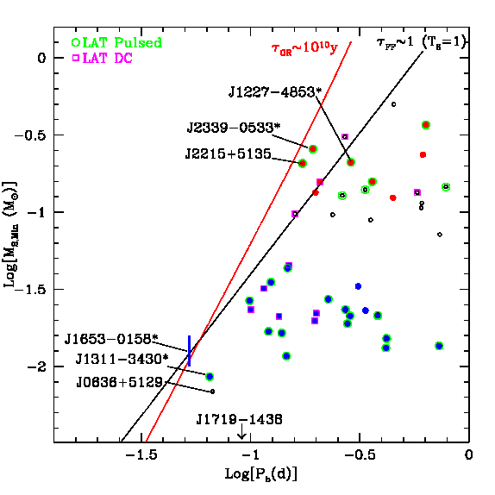
The UNIDs on the P_{B} – M_{c} plane
4/6 are short P_{B} systems near the boundary
  1 was a mislocated young PSR
  1 still to go...
3 Groups
  BW H sub*
  RB stellar
  Tid He sub*
RB
BW
Tid

Slide 7
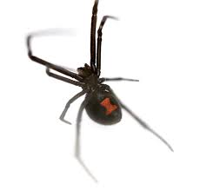
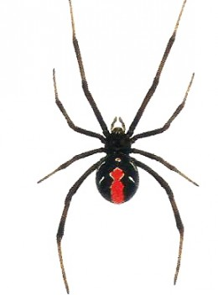
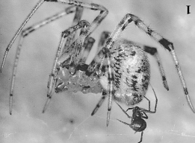
Arachnoid Nomenclature: Theridiidae
Black Widows – the original
  E.g. Latrodectus hesperus
  Ventral markings
Redbacks – Australian cousins
  Latrodectus hasseltii
  Dorsal markings
Tidarren spiders
  Tidarren sisyphoides family Theridiidae (tangle web spiders). Extreme mass ratio...
    “The male of this species is only 1% the size of the female. At copulation, the male dies during insertion and remains attached to the female for more than two hours. However, the female does not eat her mate. The dead male is afterwards removed from the web” -- wikipedia

Slide 8
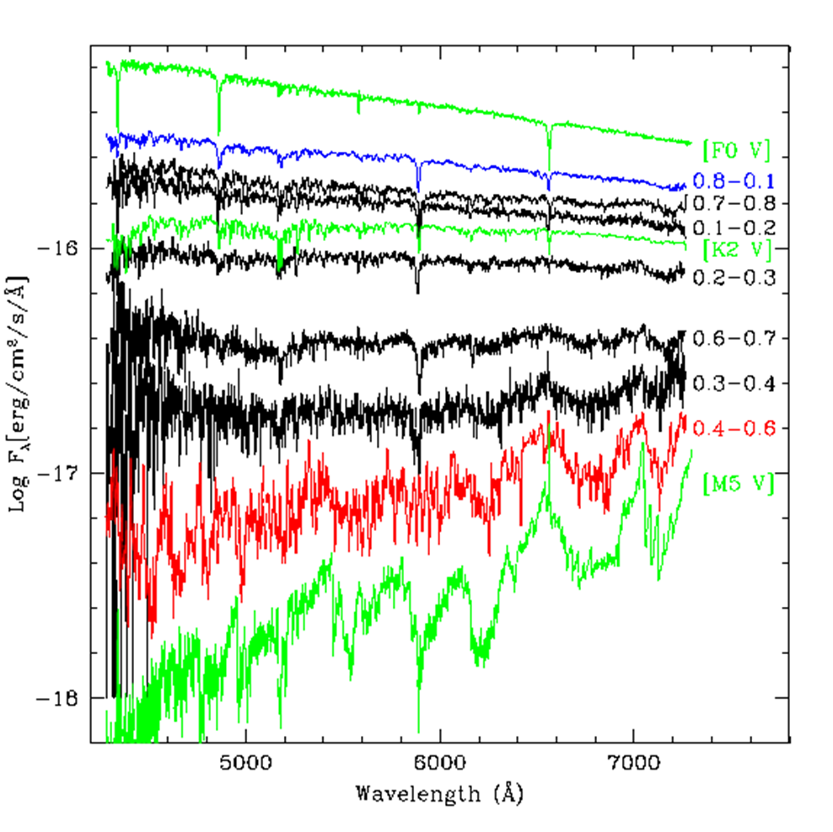
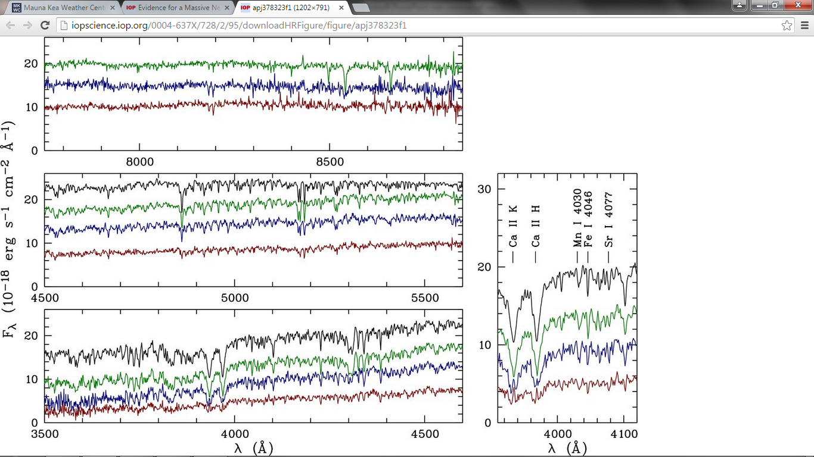
Spectral Support for Class Differences
Redbacks
  ~solar abundances
  T_{eff} sweep (mixed T)
Black widows – similar
  lower log g
  Some Na abs. excess
PSR J2239-0533
PSR J1957+2054
F2
G0
Q2
(Q)
M5
van Kerkwijk, Breton
& Kulkarni 2011
RWR & Shaw 2012

Slide 9
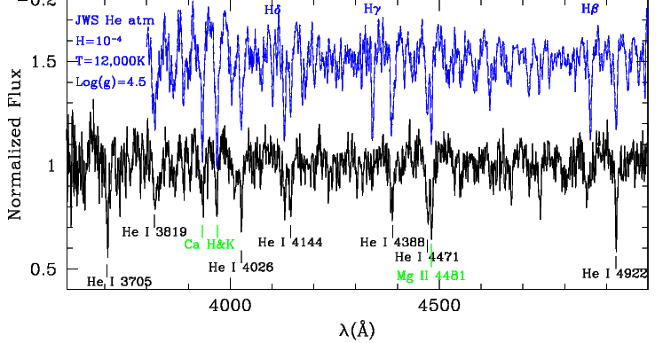
Spectral Support for Class Differences
Tidarrens
  Extreme H depletion
  Variable emission lines from winds
PSR J1311-3430

Slide 10
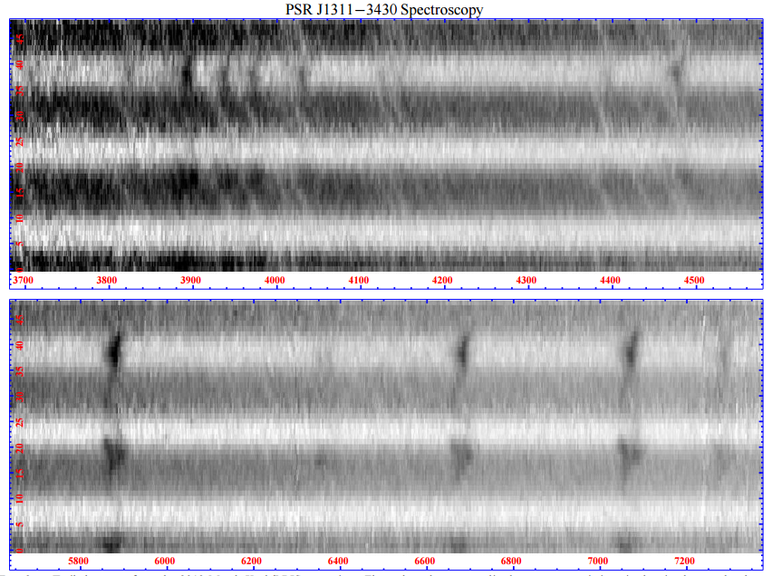
PSR J1311-3420

Slide 11
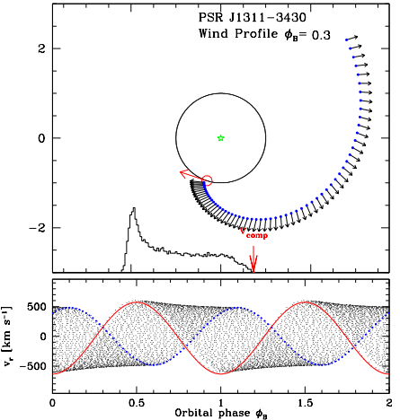
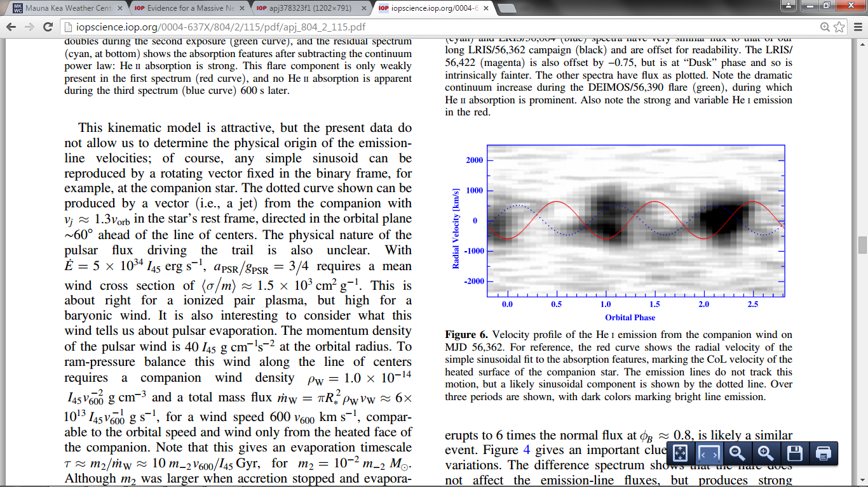
PSR J1311-3430 – wind, variability
Wind has neutral clouds
Trails companion (excretion spiral)
Variable between epochs

Slide 12
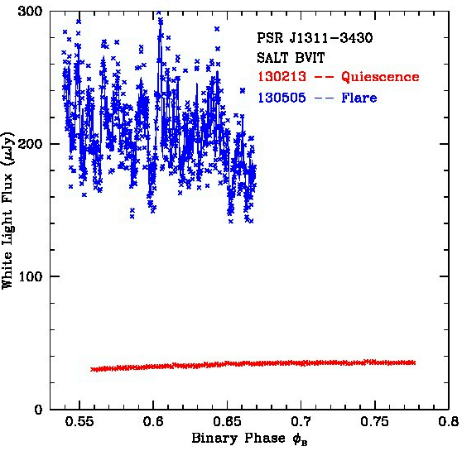
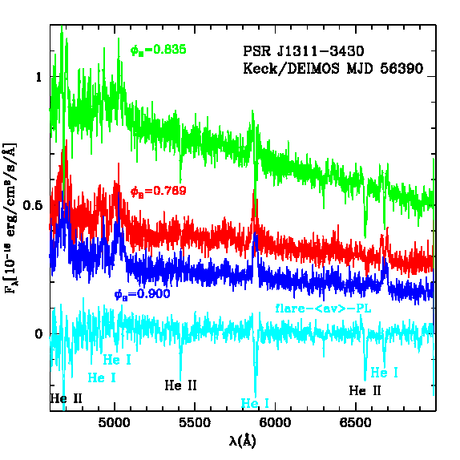
Companion Photosphere Activity
Spectra are absorption line dominated
  Deep (sub-photosphere) heating ➔ gamma-ray or particle heating (Phinney et al ‘88)
RB T_{N} are substantially larger than M_{c} equilibrium
  Deep, likely convective, energy transport
  Also BW, Tid (T_{N} detection)
J1311 Surface Flares (likely magnetic)
  Timescales downs to ~20s (BVIT)
  Few % duty cycle
  Spectra: He II 6560 abs @ 40,000k!
  Similar activity in light curve of several P_{B}<4h objects
SALT/BVIT
Photometry
In
Quiecence and
Flare States
3x300s consecutive exposure
RWR, AVF & SBC 2015

Slide 13
Open Questions: Interaction & Evolution
What, precisely, does the heating?
  Particles from the PSR? E x B? IBS radiation? IBS particles?
Do RB turn into BW? Into Tidarrens?
Is Tidarren evaporation a viable path to planet PSR and beyond to single MSP? How about BW?
  B1959+2054 – unclear
  J1311-3430 – yes!! (momentum flux in wind > L_{PSR}/c)
Next, Summarize Evolution, if time permits

Slide 14
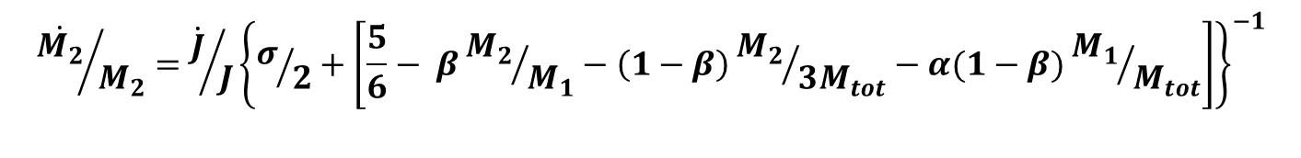

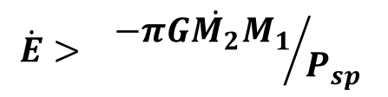
Tight Binary MSP Evolution in the P_{b}-M_{c} plane
Out of Contact
  Shrinks to smaller P_{b} under GR (horizontal)
RLOF
  At contact drives along R(M)=M^{σ} lines (diagonal)
Pulsar `spin battery’ complicates this:
  Accretion `Recycles’ PSR, storing energy
  Decreases B field
E_{PSR} can drive evaporative wind from M₂ (~vertical)
  Key Issue. Can PSR wind break through M₂ loss?
  to breakout at R_{LC} to maintain
$${\dot{M_{2}}}/{M_{2}}={\dot{J}}/J{\left\{σ/2+\left[\frac{5}{6}− β{M_{2}}/{M_{1}}−\left(1−β\right){M_{2}}/{3M_{tot}}−α(1−β){M_{1}}/{M_{tot}}\right]\right\}}^{−1}$$
$${\dot{M}}_{2}(w)≈{f_{ev}{\dot{E}}_{PSR}}/{2{v_{esc}}^{2}}{\left({R_{2}}/a\right)}^{2}≈{f_{ev}}/{2G}{{\dot{E}}_{PSR}{R_{2}}^{3}}/{M_{2}a^{2}}$$
$$\dot{E}>{ −πG\dot{M_{2}}M_{1}}/{P_{sp} }$$
$$\dot{E}>{−G\dot{M_{2}}M_{1}c}/{2a}$$

Slide 15
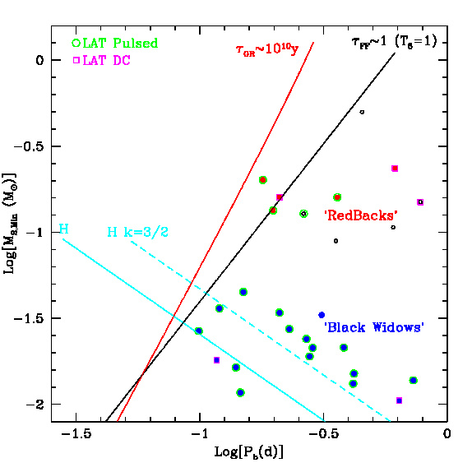
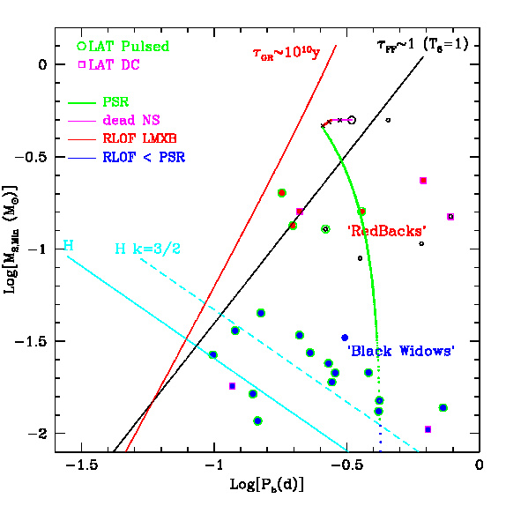
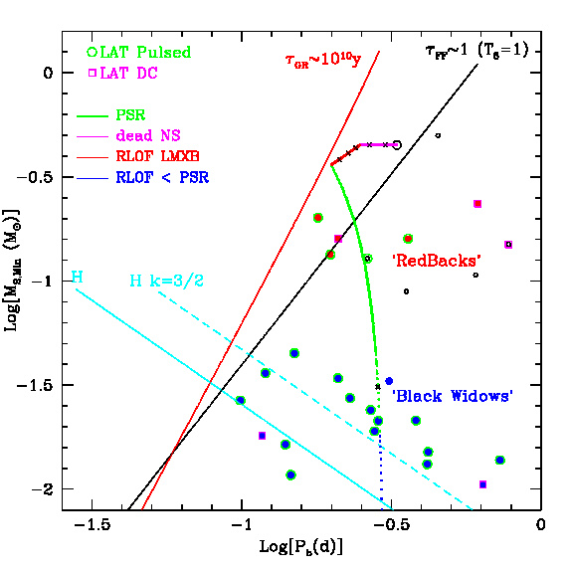
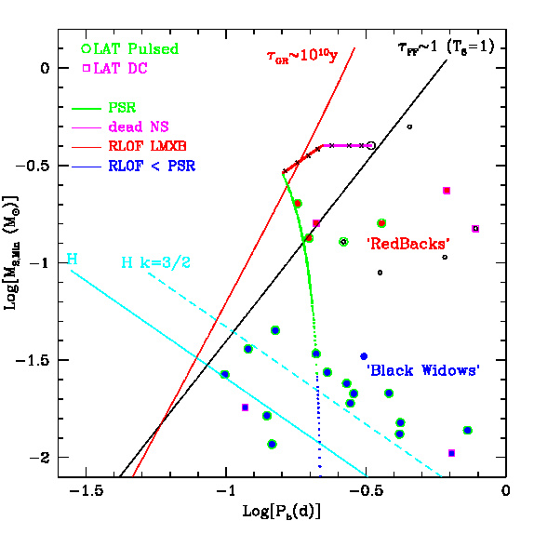
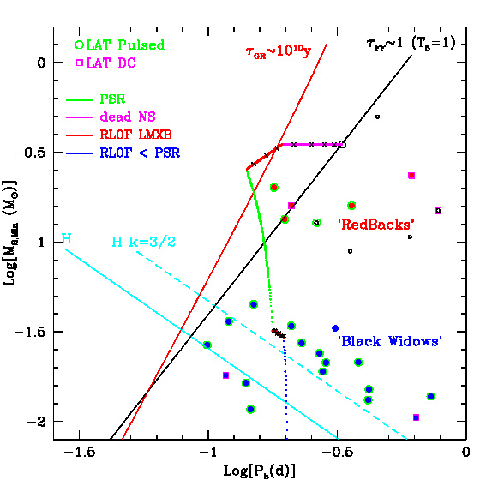
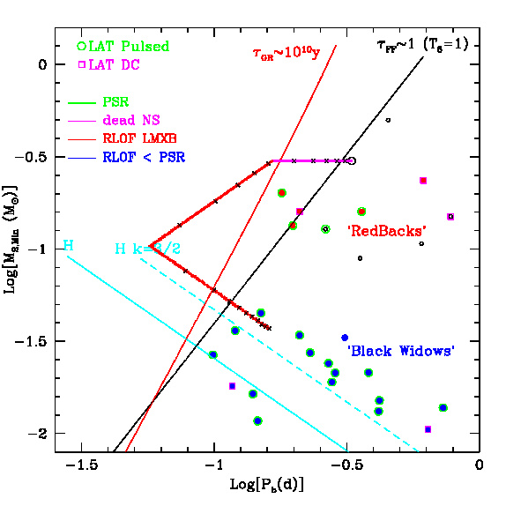
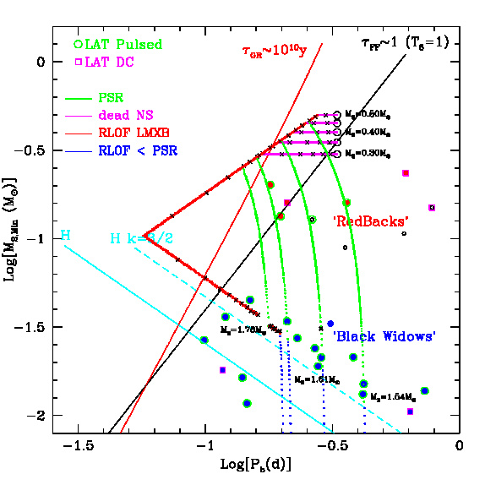
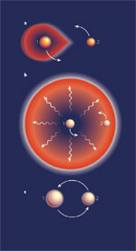
It all starts
with a
Common
Envelope
P_{b}=8h
M₂=0.50M_{o}
M₂=0.30M_{o}
M₂=0.45M_{o}
M₂=0.40M_{o}
M₂=0.35M_{o}
Dense, Ionized
Plasma:
Difficult to
Detect Radio

Slide 16
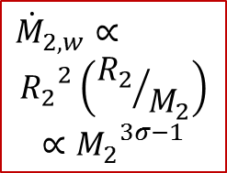
Breakout
To RB/BW
M_{w} α M²
$${\dot{M}}_{2,w}∝$$
$${R_{2}}^{2}\left({R_{2}}/{M_{2}}\right)$$
$$∝{M_{2}}^{3σ−1}$$
M_{w} α M⁻²

Slide 17
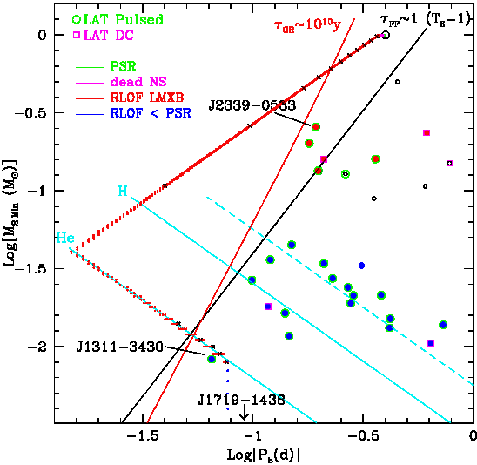
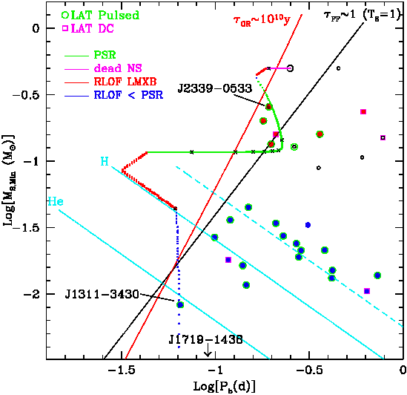
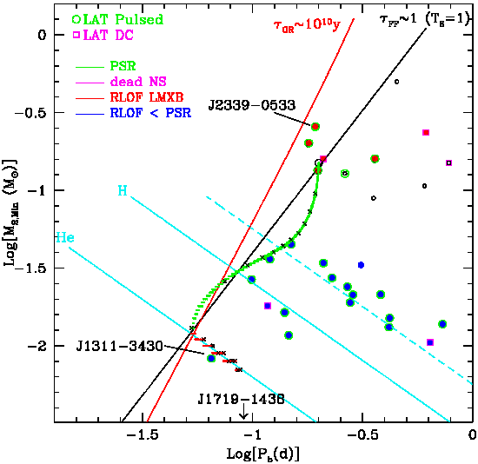
How to Produce Tidarrens (e.g. J1311)
Can drive from evolving M_{c} → UCXB w/ He core, evap
or RB → BW → contact and/or evap
or LMXB → RB → LMXB → BW+evap
Large M₂, slow transfer ΔM₂>1M_{o}, He core
ΔM₂ ~0.1-0.2M_{o} Breakout to J1311-3430

Slide 18
Mass Transfer and the NS Mass limit
Some evaporating pulsars have experienced long, low dM/dt mass-transfer phases
  Allows large ΔM deposition, unlike nuclear evolution-driven, wider NS+WD binaries
  Black widows direct from LMXB phase
  Especially Tidarrens from UCXB phase
These may be among the heaviest possible NS.

Slide 19
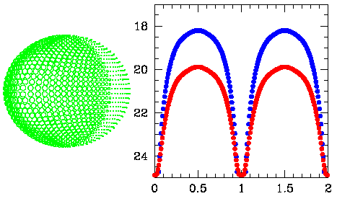

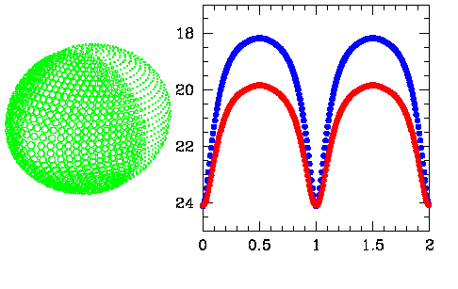
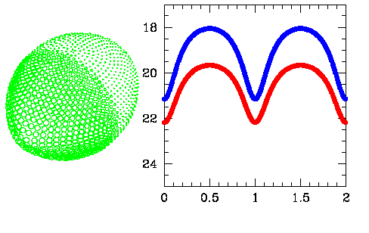
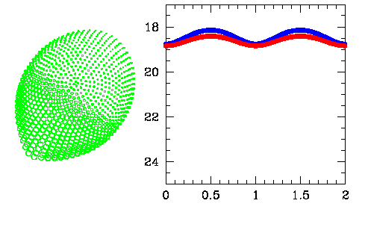
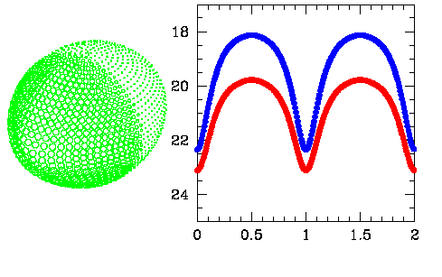
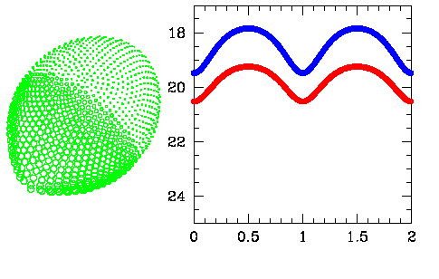
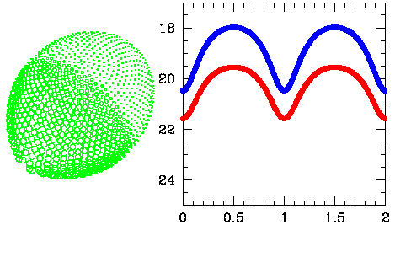
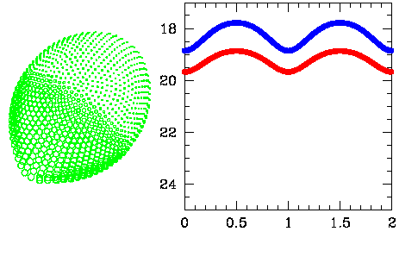
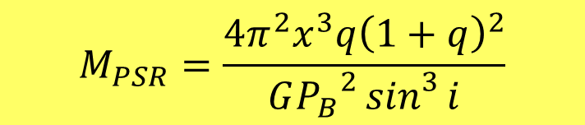
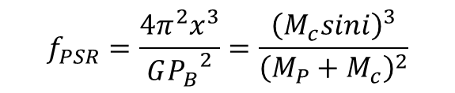
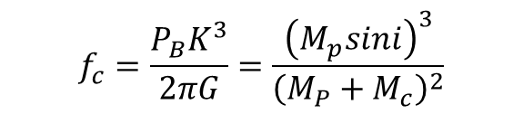
Measuring M_{NS} (the fond hope)
Radio/γ-ray timing give pulsar projected orbit x=a_{PSR} sin i (lt-s)
So we need mass ratio q=M_{P}/M_{c} and inclination i
NS+WD, NS+NS binaries – relativistic effects esp. Shapiro delay
Companion wind taketh while companion flux giveth
  Companion spectroscopic radial velocity gives second mass function (i.e. q)
  photometric light curve gives i
$$f_{PSR}=\frac{4π^{2}x^{3}}{G{P_{B}}^{2}}=\frac{{\left(M_{c}sini\right)}^{3}}{{\left(M_{P}+M_{c}\right)}^{2}}$$
$$M_{PSR}=\frac{4π^{2}x^{3}q{\left(1+q\right)}^{2}}{G{P_{B}}^{2}\sin^{3}{i}}$$
$$f_{c}=\frac{P_{B}K^{3}}{2πG}=\frac{{\left(M_{p}sini\right)}^{3}}{{\left(M_{P}+M_{c}\right)}^{2}}$$

Slide 20
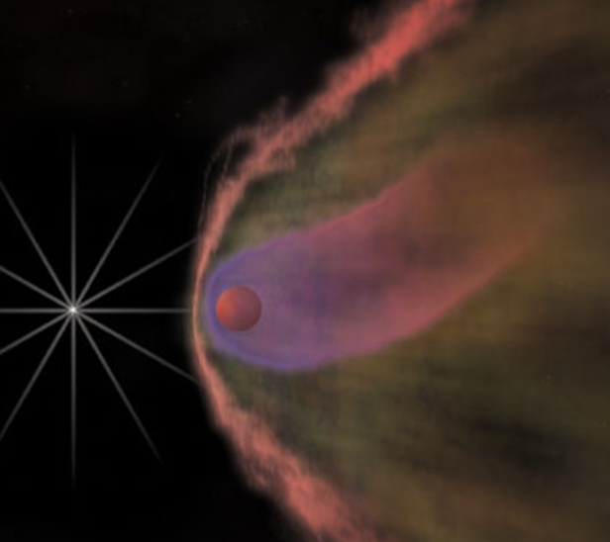

Measuring M_{NS} (the messy truth)
Heating displaces center of light from center of mass
Thus true radial velocity is larger by K_{cor}=K_{CoM}/K_{CoL} .
Since
even subtle changes in the heating pattern dominate i and K_{cor} estimates ➔ large effect on inferred mass
CoL
CoM
$$M_{PSR}=\frac{4π^{2}x^{3}q{\left(1+q\right)}^{2}}{G{P_{B}}^{2}\sin^{3}{i}}$$
$$∝{\left({K_{cor}}/{\sin{i}}\right)}^{3}$$

Slide 21
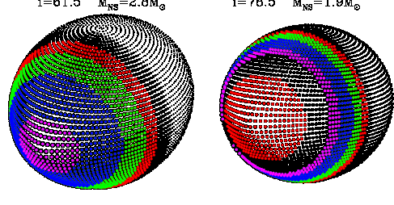
Example: Tid J1311-3430
Standard light curve fitting (ELC, W-D, ICARUS) assume (as for LMXB) radiative heating by a point source or accretion disk.
With new high quality photometry, light curves fits are poor
  Demands ‘L_{X}’ > L_{PSR} ...
  Asymmetry in several cases Δφ~0.01
  Poor match to colors at peak
  bad minima (χ2/DoF ~3-10)
E.g. J1311-3430
  Direct heating fit M_{NS}=2.68+/-0.14 M_{o}
  But large L_{X} , high inclination
  Artificial cool spot at L₁ increases i, decreases M_{NS}. Best fit has unphysical pattern; allowing arbitrary pattern allows M_{NS} ~1.9-2.9 M_{O}.
  Can similar effects decrease the M_{NS}=2.40+/-0.12M_{o} for PSR J1959+2154 (van Kerkwijk, Breton & Kulkarni 2011 )??
RWR et al 2014

Slide 22
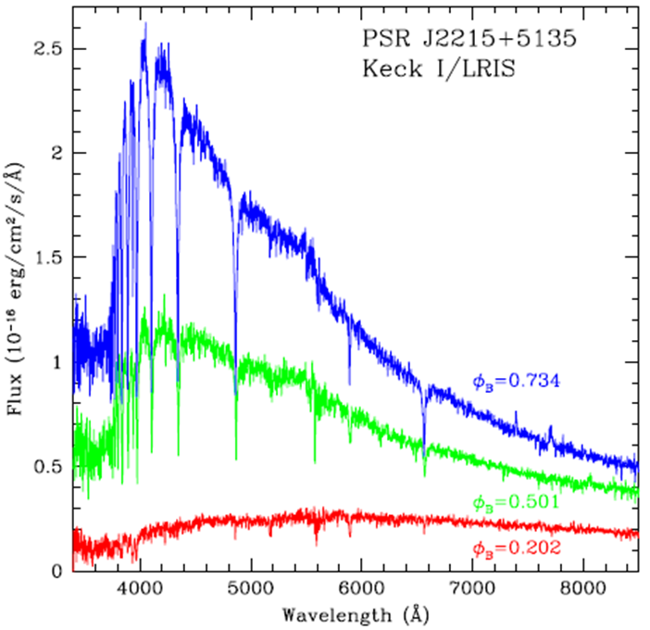
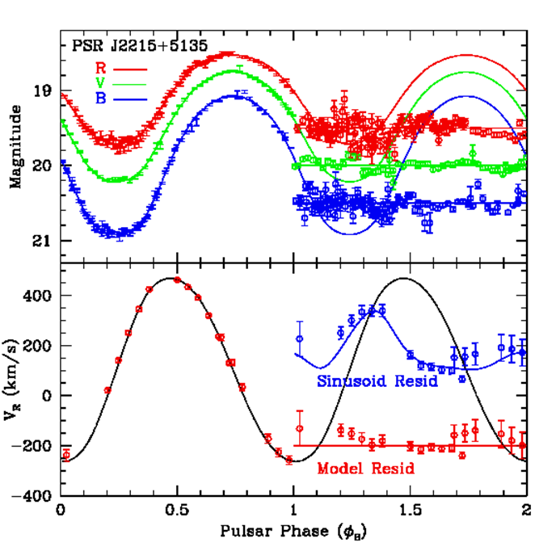
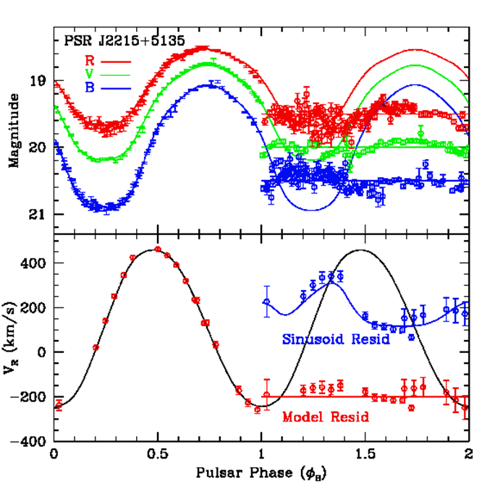
Example – RB J2215+5135
Schroeder & Halpern (2014) MDM photometry, ELC fit M_{PSR} = 2.45^{+0.22}_{-0.11}M_{O}!
  We took Keck spectra: T_{obs} >> T of ELC fit
  Radial velocity large
  Direct Heating ELC fit gives M_{P}=3.88M_{O} M_{c}=0.53M_{O}. Crazy!
  Fit using Tobs constraint M_{P}=1.60M_{O}/M_{c}=0.23M_{O}
RWR et al 2015
Heating
Model
Errors

Slide 23
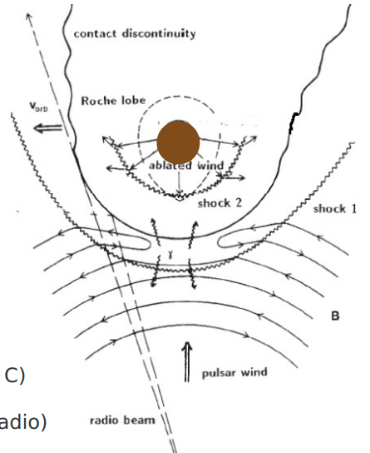

The Fix(?): IntraBinary Shock
ESP
Particles, not radiation (spectrum)
Deep heating, L₁ B field (Keck data)
  B field may guide particles off L₁ point
Shock-generated particle illumination:
  Subtends larger PSR solid angle
  More Uniform T_{D} → larger i, smaller M_{NS} .
  Assymmetric illumination
β=wind flux ratio
v_{w} rel v_{orb}

Slide 24
M_{NS} Measurements: A Work in Progress
Improved heating pattern
  Smaller light curve, color and RV residuals
Lock down K_{corr}, i measurements
RB – minimum ΔM for spin-up?
BW – ΔM test for RB or direct path
Tids – probe toward M_{max} .

Slide 25

The Heaviest Neutron Stars → EOS
BW and Tids
PSRs J1640+2230, J0348+0432
Lattimer 2010

Slide 26



And if they overdo?
BW, Tid may exceed maximum ΔM:
  M>M_{max} (2-3M_{O}) in the `mass gap’
  Collpase to BH + planetary mass companion
  Companion heating ceases: optically faint
  May occasionally evolve to faint, UCBHB with low M_{BH}:
  $τ_{GR}≈1.1×{10}^{10}y{\left(\frac{{2.5M}_{0}}{M_{BH}}\right)}^{2/3}\left(\frac{0.01M_{0}}{M_{c}}\right){P_{90min}}^{8/3}$
Belczynski et al 2012
10 M_{J}

Slide 27
Conclusions
Fermi: a BW/RB/Tid discovery machine
  Searches of UNIDs → deeply shrouded MSP
UNIDed sources → Tidarrens are esp. interesting:
  Super-short periods, unique He companions
  Extreme winds and Intrabinary shocks
  Large mass transfer, high mass NS
High Mass BW, Tids will test the Equation of State:
  Any above ~2.2M_{O} narrows to stiff only, >2.5M_{O} at limits of QCD physics
  Mass, I tracers probe history of close binary interaction

Slide 28

Finis
extras

Slide 29

Moment of Inertia
Brownsberger & RWR 2014
PSR J0437-4715
PSR J1959+2048

Slide 30


