Slide 1
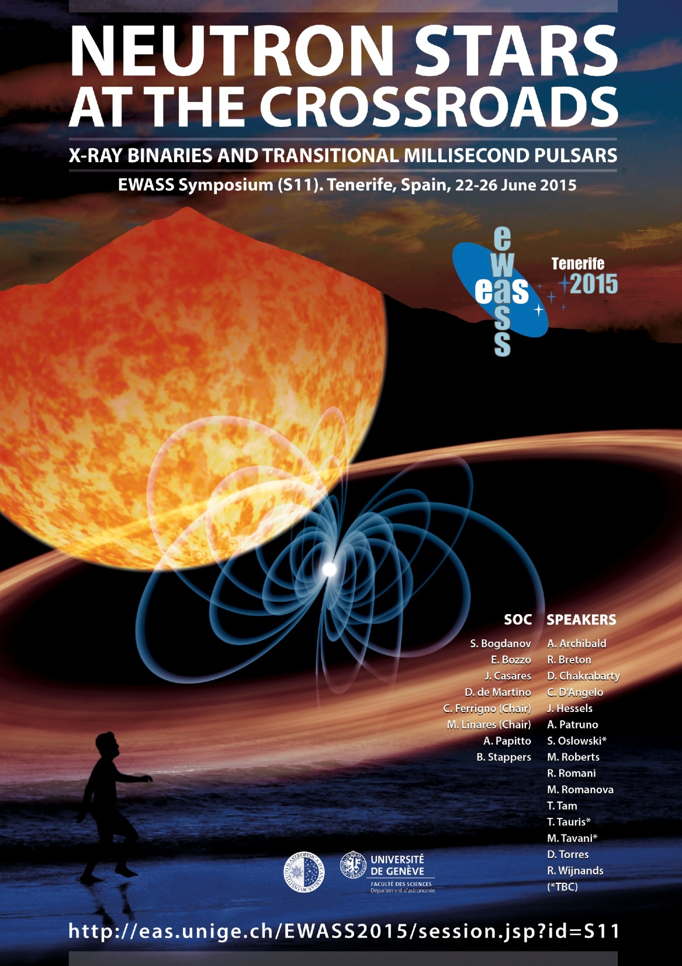

Slide 2

Welcome!

Slide 3
Brief NS history: accretion vs. rotation
1962: 1st LMXB (Accretion power)
1968: 1st PSR (Rotation power)
1972: Accretion disc theory
1978: Cyclotron lines, ~Thermonuclear Bursts
1982: 1st MSP, Recycling Scenario
1988: 1st *eclipsing* MSP (black widow)
1992: Gamma-ray pulsars
1998: 1st *accreting* MSP
2002: FIRST J102347.6+003841
2008: PSR J1023+0038
…
2013!: IGR J18245-2452 – M28-I

Slide 4
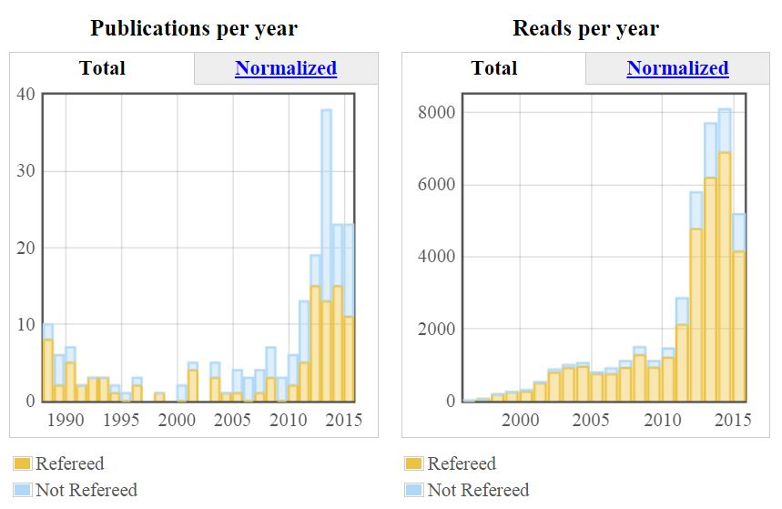
The Boom: 2009-2015
SOURCE: NASA-ADS
Query words: BLACK WIDOW; BLACK WIDOWS; ECLIPSING MILLISECOND PULSAR; ECLIPSING MILLISECOND PULSARS; REDBACK; REDBACKS

Slide 5
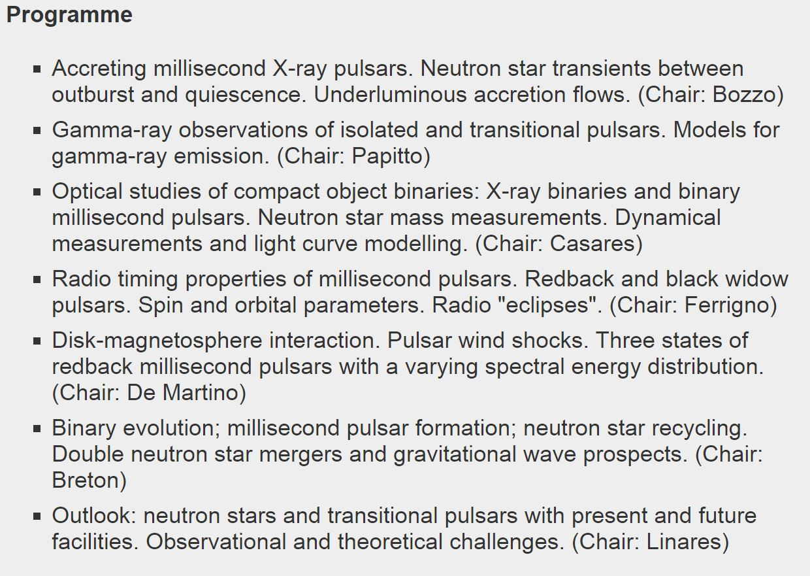
This Symposium: multi-disciplinary
Speakers (upload your talk in advance, room 0.1):
time = talk + Q&A (min):
30 = 25 + 5
25 = 20 + 5
15 = 12 + 3
10 = 8 + 2
Please comply!
All:
Discussion!
See Posters!
Sessions start:
THU: 11:15, 15:00, 17:00
FRI: 9:00, 15:00, 17:00
Scientific organizers:
Chairs: M. Linares (IAC) & C. Ferrigno (ISDC).
S. Bogdanov (Columbia), E. Bozzo (ISDC), J. Casares (IAC), D. de Martino (INAF-OACN), A. Papitto (IEEC-CSIC), B. Stappers (Manchester)

Slide 6
Let’s Get Started!

