Slide 1
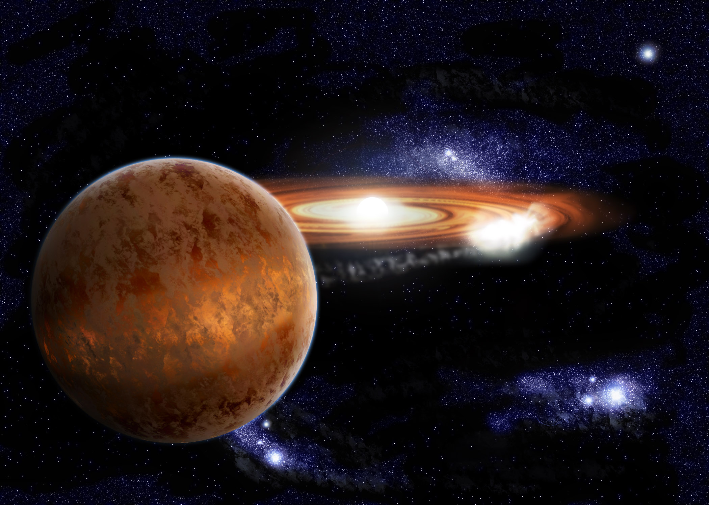
Sub-Eddington accretion flows in neutron-star low-mass X-ray binaries
Rudy Wijnands
Astronomical Institute “Anton Pannekoek”
University of Amsterdam
25 June 2015
Tenerife

Slide 2
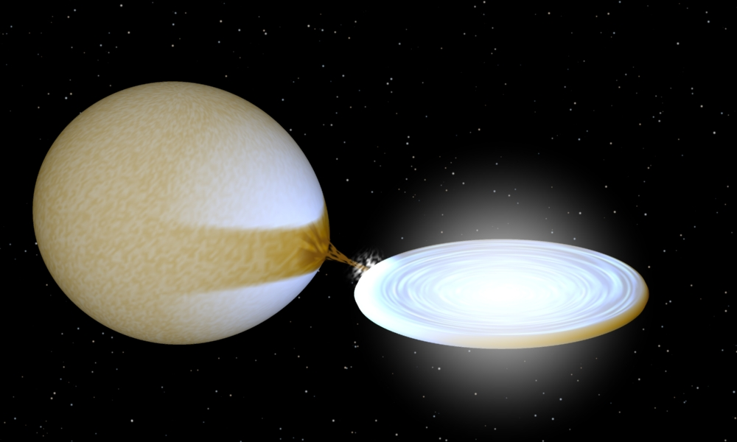
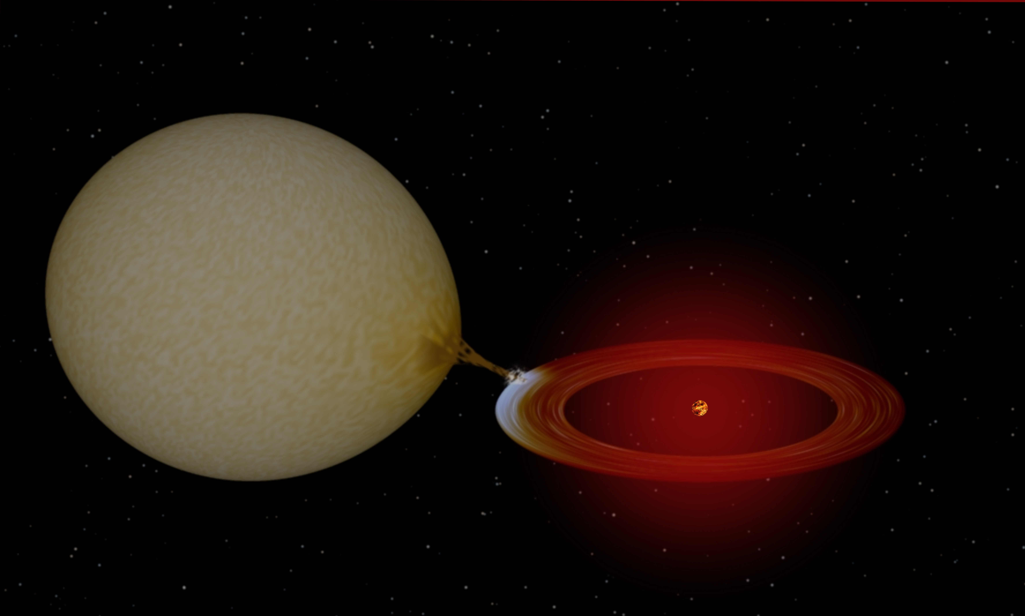

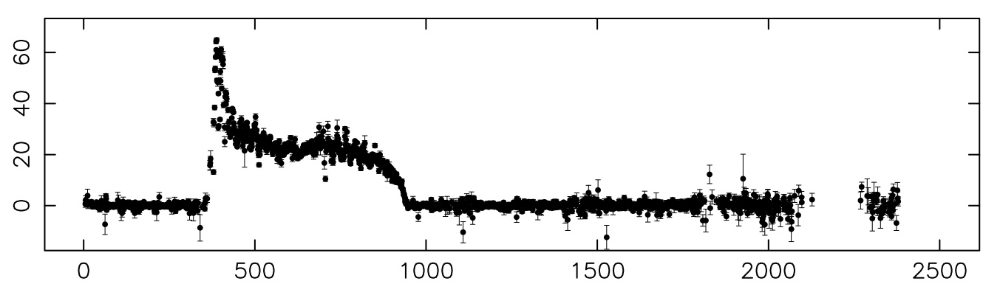
Low-mass X-ray binary transients
Outburst
Disk
Instability
Model
Quiescence
X-ray luminosity
Time in days

Slide 3
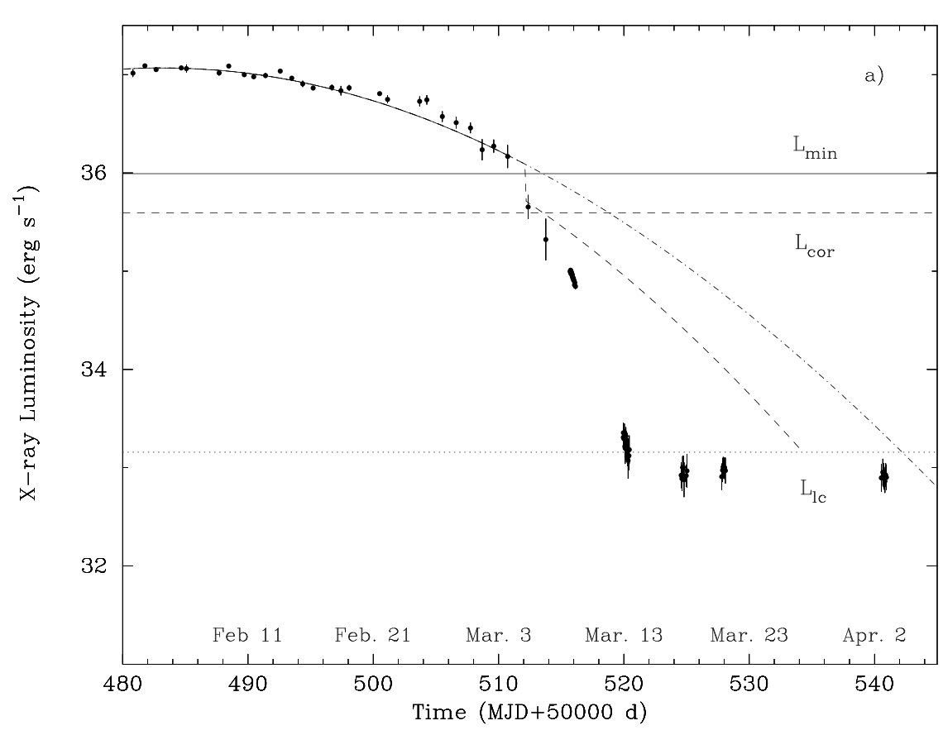
Transition to quiescence of bright transients
Aql X-1
10³⁶ erg s⁻¹
Campana et al. 1998
As the DIM
would like it!

Slide 4
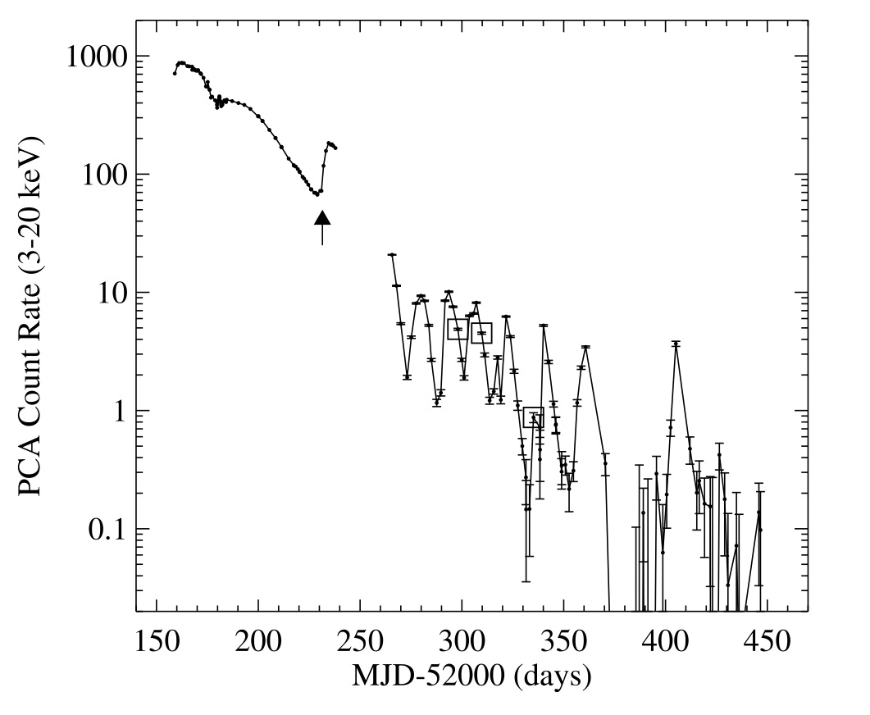
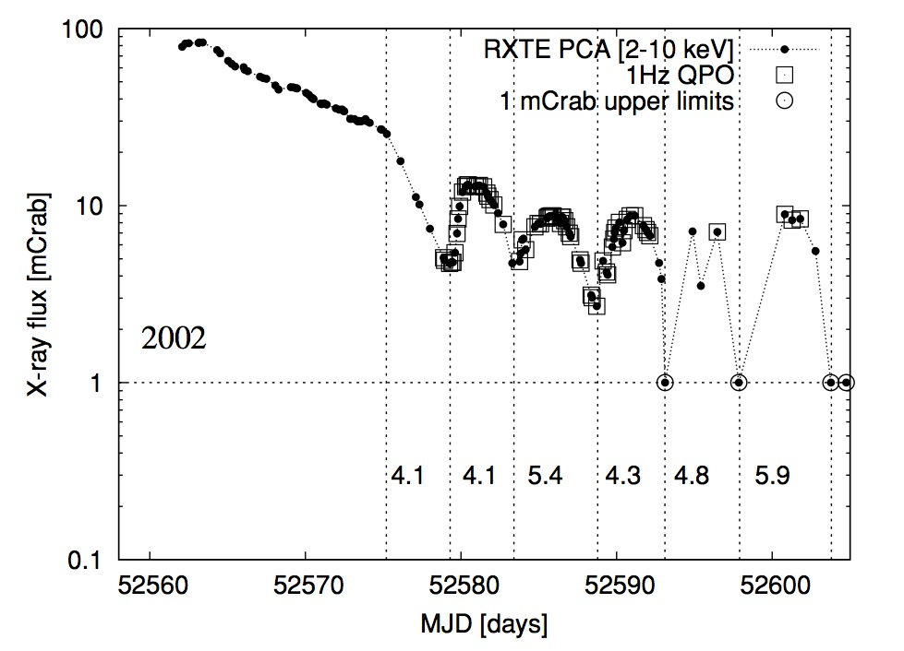
Bubbling
XTE J1650-500 (BH) SAX J1808.4-3658 (NS)
Tomsick et al. 2004
Patruno et al. 2009
This behavior is still not understood!

Slide 5
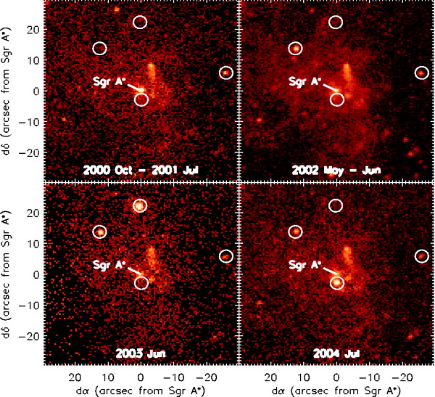
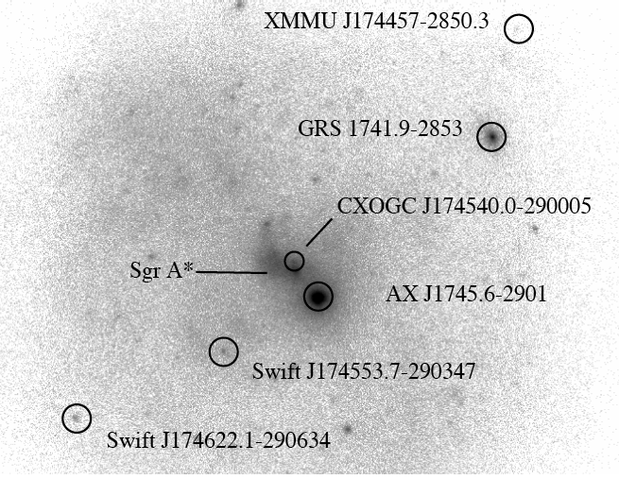
Very-faint X-ray binaries
Never become brighter than 10³⁶ erg s⁻¹
40+ known; both transients and persistent systems
  See talk of Arash Bahramian
XMM J174457-2850.3
GRS 1741.9-2853
Muno et al. 2005
Degenaar & Wijnands 2009, 2010
Notes:
Brightly explain what very-faint X-ray transients are and the image are Chandra data from the mid-2000s. Preliminary work done by Muno and Wijnands. But the monitoring program talked about in the previous slide showed the very nice light curve of GRS 1741.9-2853. All Swift data! Different Lx_peak and highligh the mini-outburst with Lx Peak of a few 1e 34 erg/s only!! Quite idfferent from the brightest peak of Lx _peak = 1e36 erg/s!
And of course there are very faint transients X-ray binaries. Sources that spend most of the time in a dim quiescence state, but sometimes experiment outburst where the luminosity increase orders of magnitude. In the case of the very faint systems, the peak luminosity reach 10^34 to 10^36 ergs per sec.
In these images of the Galactic Center taken with Chandra between 2000 and 2004, we can see the brightness increase due to outbursts of different sources.
The first works were done by Muno and Wijnands, and our “galactic center’ monitoring program also produced nice light curves.
For example the light curve of GRS1741. Since the monitoring started in 2006, the source has experimented few outbursts with different peak luminosities. One of them, in 2006,was very faint, 10^34 ergs per second.

Slide 6
Accretion physics
Problems for the disk-instability model?
  Too many free parameters in DIM to say anything
What is the accretion geometry at those low luminosities?
  Truncated disk?
  RIAF like accretion flows? Any outflows?
  Is accretion flow the same for all systems?
  Importance of a neutron star in the center
    Surface becomes visible
    Do we enter the propeller regime in some systems?

Slide 7
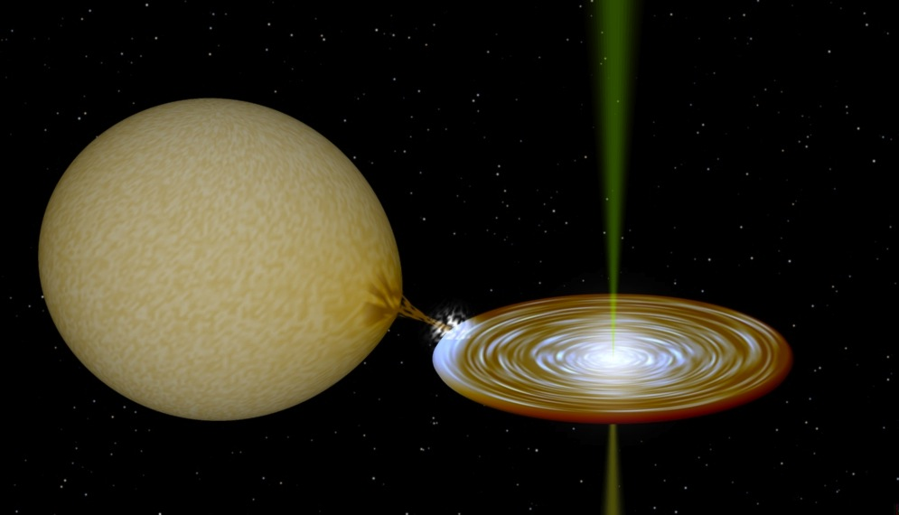
Accretion physics
Problems for the disk-instability model?
  Too many free parameters in DIM to say anything
What is the accretion geometry at those low luminosities?
  Truncated disk?
  RIAF like accretion flows? Any outflows?
  Is accretion flow the same for all systems?
  Importance of a neutron star in the center
    Surface becomes visible
    Do we enter the propeller regime in some systems?

Slide 8
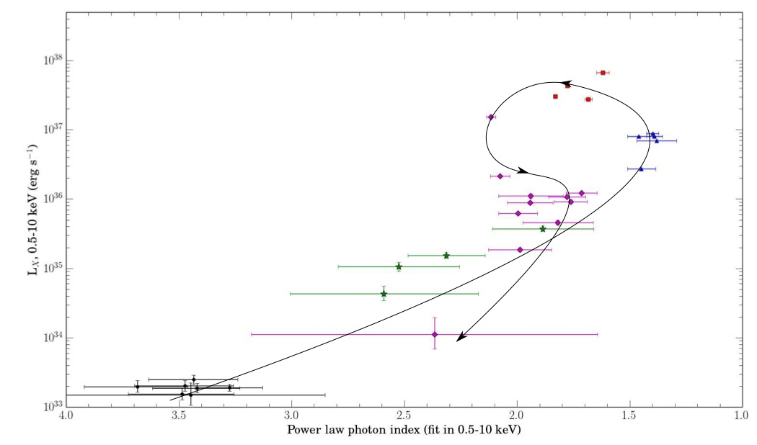
Spectral evolution
Sources become softer when L_{x} decreases
Terzan 5 X-3
Bahramian et al. 2014
Soft
Hard
Very common behavior (both NSs as well as BHs)

Slide 9
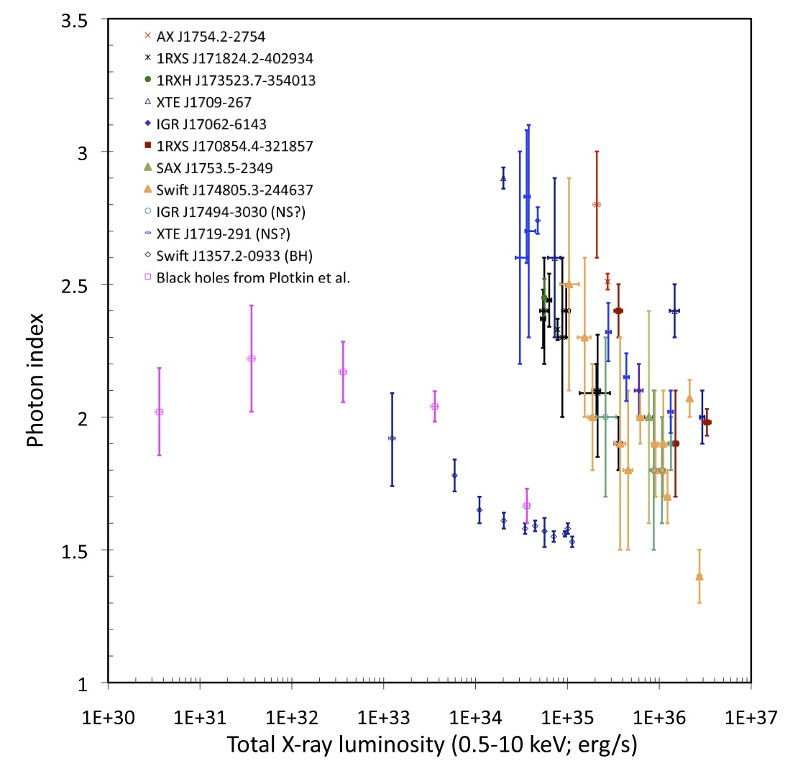
Wijnands et al. 2015

Slide 10
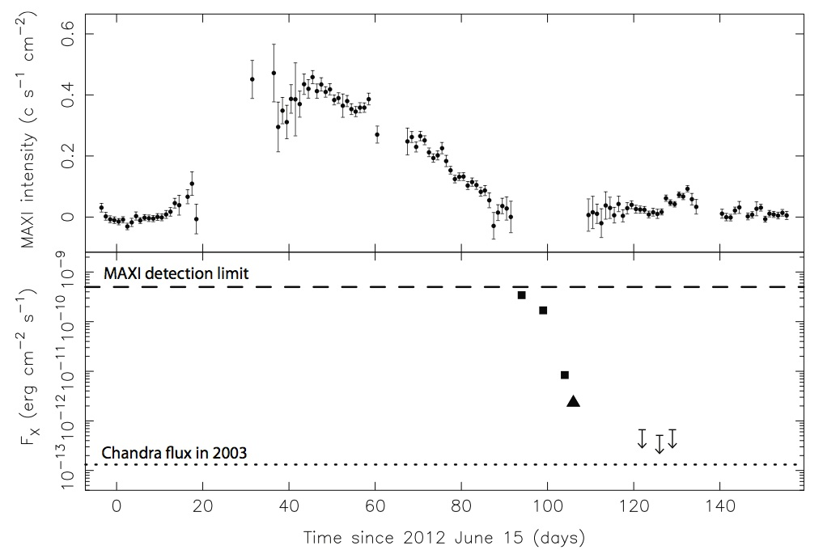
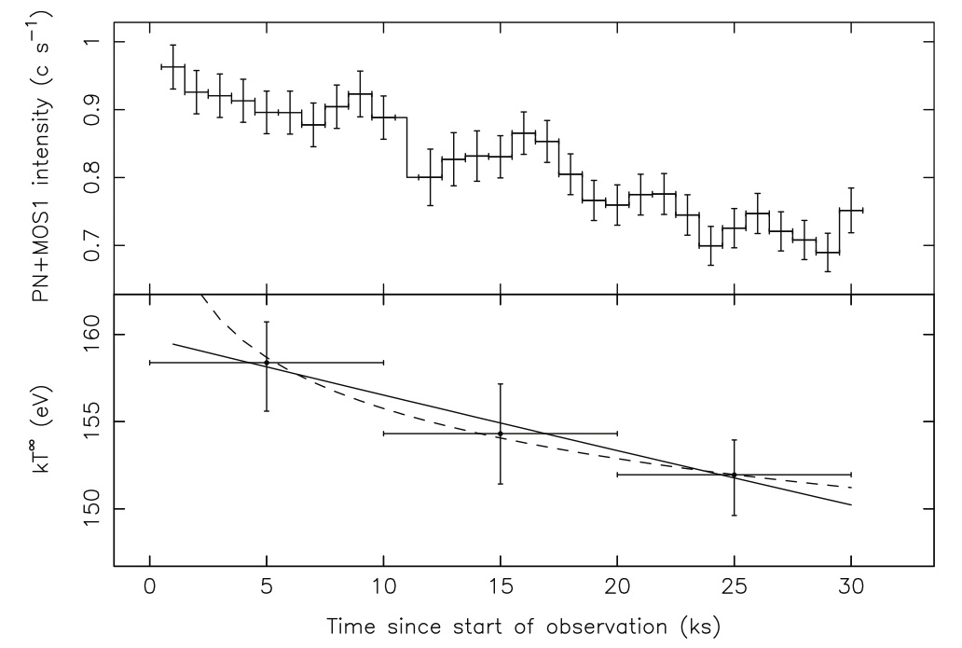
NS becoming visible
XTE J1709-267
Degenaar et al. 2013
Presence of black-body like component, likely from the NS surface
When NS component added to the model, power-law becomes much harder (photon index 1-1.5)!

Slide 11
NSs at extremely low accretion rates
So what at lower (< 10³⁴ erg s⁻¹) luminosities?
Wijnands et al. 2015
Quiescence

Slide 12
Several options
  Accretion totally switches off: “true” quiescence
    Spectrum dominated by soft component
    Cooling studies of accretion-heated neutron stars
  ‘We have no clue what is going on’ state
    Power-law dominated spectrum, very hard
    Connection with the ‘transition pulsars’?
  Low-level accretion continues
    Spectra very similar as when at higher luminosities!
    Soft component with very hard power-law (Γ ~1-1.5)

Slide 13
NSs at extremely low accretion rates
So what at lower (< 10³⁴ erg s⁻¹) luminosities?
Wijnands et al. 2015

Slide 14
Several options
  Accretion totally switches off: “true” quiescence
    Spectrum dominated by soft component
    Cooling studies of accretion-heated neutron stars
  ‘We have no clue what is going on’ state
    Power-law dominated spectrum, very hard
    Connection with the ‘transition pulsars’?
  Low-level accretion continues
    Spectra very similar as when at higher luminosities!
    Soft component with very hard power-law (Γ ~1-1.5)

Slide 15
NSs at extremely low accretion rates
So what at lower (< 10³⁴ erg s⁻¹) luminosities?
Wijnands et al. 2015
tMSP

Slide 16
Several options
  Accretion totally switches off: “true” quiescence
    Spectrum dominated by soft component
    Cooling studies of accretion-heated neutron stars
  ‘We have no clue what is going on’ state
    Power-law dominated spectrum, very hard
    Connection with the ‘transition pulsars’?
  Low-level accretion continues
    Spectra very similar as when at higher luminosities!
    Soft component with very hard power-law (Γ ~1-1.5)

Slide 17
A model of the spectral evolution
First option: power-law is always coming from the same physical mechanism
L_{X}
Energy
L_{X}
L_{X}
L_{X}
L_{X}
Energy
L_{X}
Energy
Energy
Energy
Decreasing luminosity
10³⁶ erg s⁻¹ 10³⁵ erg s⁻¹ 10³⁴ erg s⁻¹
Energy

Slide 18
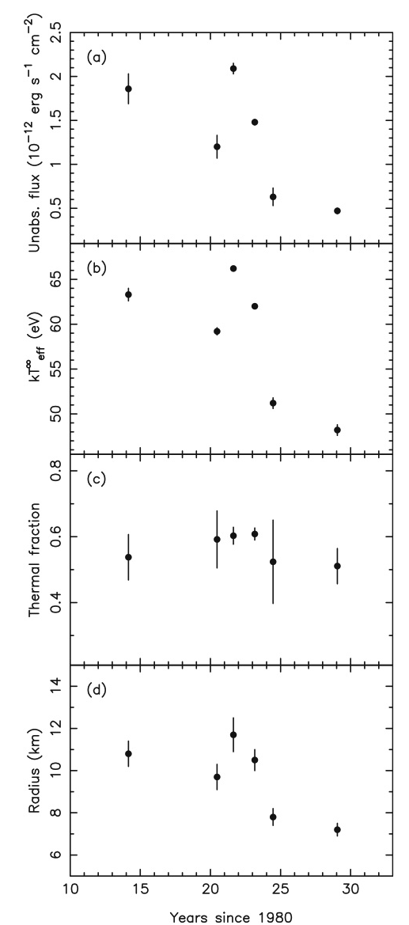
In favor:
  Need only one mechanism to produce a power-law component in the spectrum
Against:
  Power-law component first becomes softer to become harder again when the luminosity decreases
    In black holes the power-law becomes and stays soft when luminosity decreases
  Intimate connection between the soft and the hard power-law components
    Roughly equal flux (0.5-10 keV) in both components over a large range of luminosities
    Likely soft and hard components originate from the same physical process
Cackett et al. 2010

Slide 19
Second option: power-law comes from different physical mechanisms
  Maybe up to three different mechanisms
Currently no conclusive answer!
L_{X}
Energy
L_{X}
L_{X}
L_{X}
L_{X}
?
Energy
Energy
Energy
Energy
Decreasing luminosity
L_{X}
10³⁶ erg s⁻¹ 10³⁵ erg s⁻¹ 10³⁴ erg s⁻¹
Energy

Slide 20
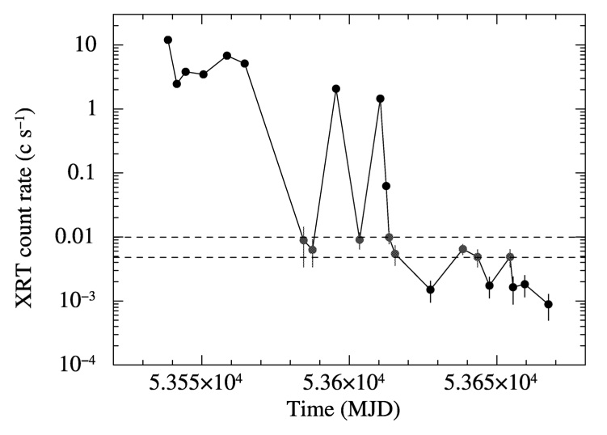
Extremely low luminosity states
SAX J1808.4-3658
~5 x 10³² erg s⁻¹
~1.5 x 10³² erg s⁻¹
Quiescence = ~5 x 10³¹ erg s⁻¹
Campana et al. 2008

Slide 21
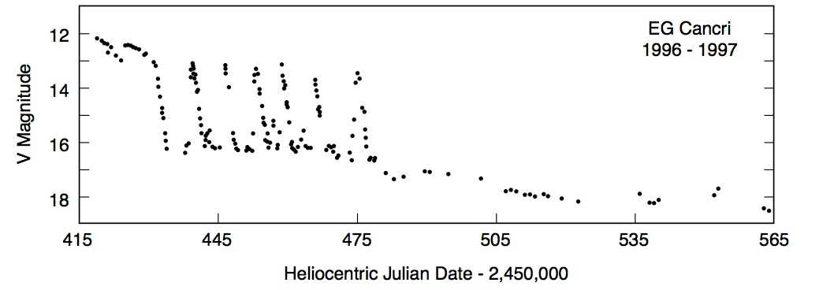
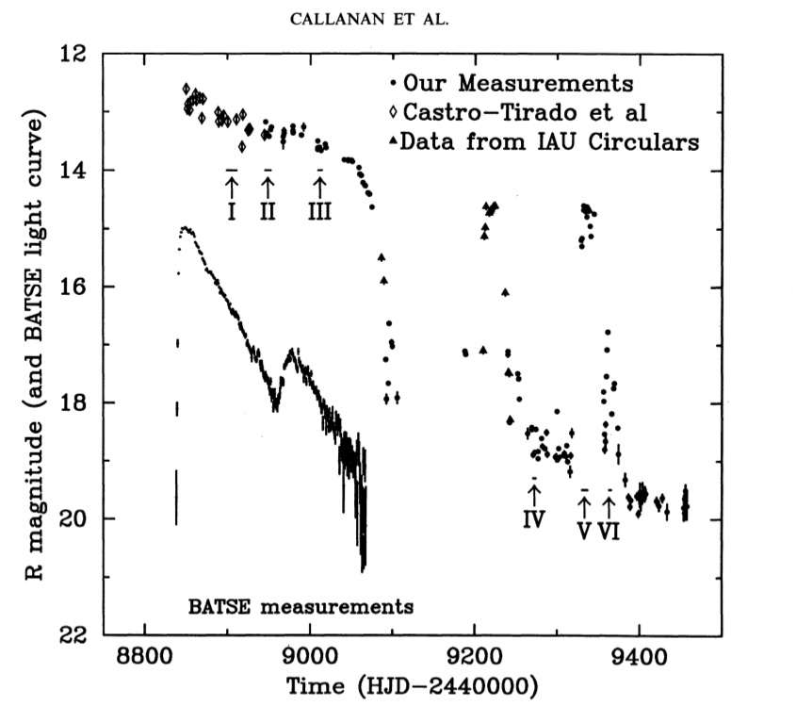
Osaki et al. 2001
1995
SAX J1808.4-3658
GRO J0422+32
Campana et al. 2008

Slide 22
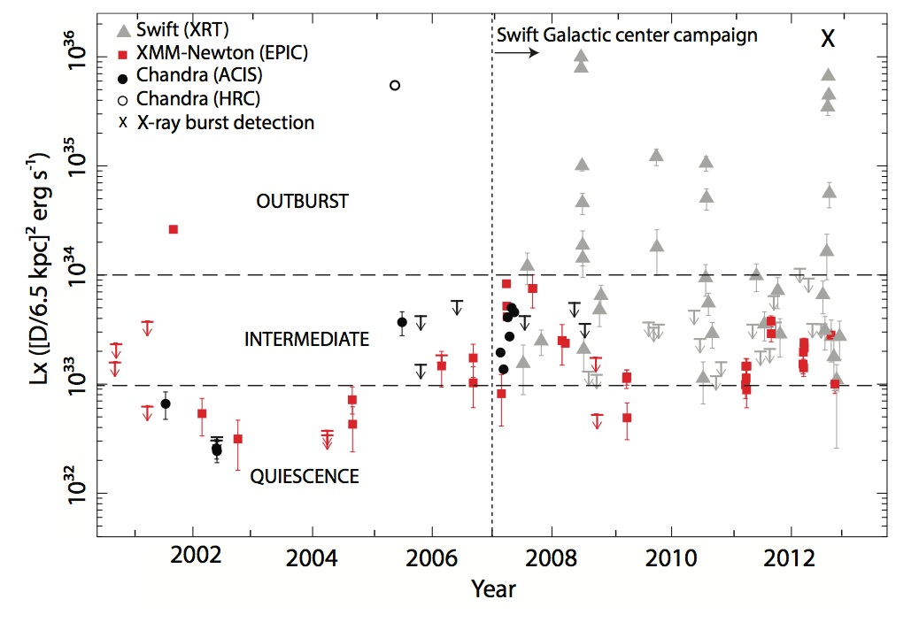
XMM J174457-2850.3
Degenaar et al. 2014

Slide 23
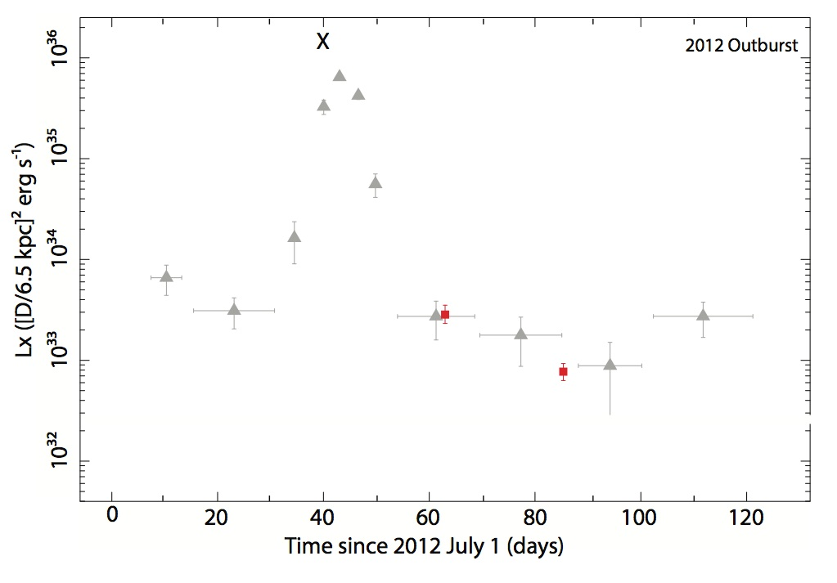
XMM J174457-2850.3
Degenaar et al. 2014

Slide 24
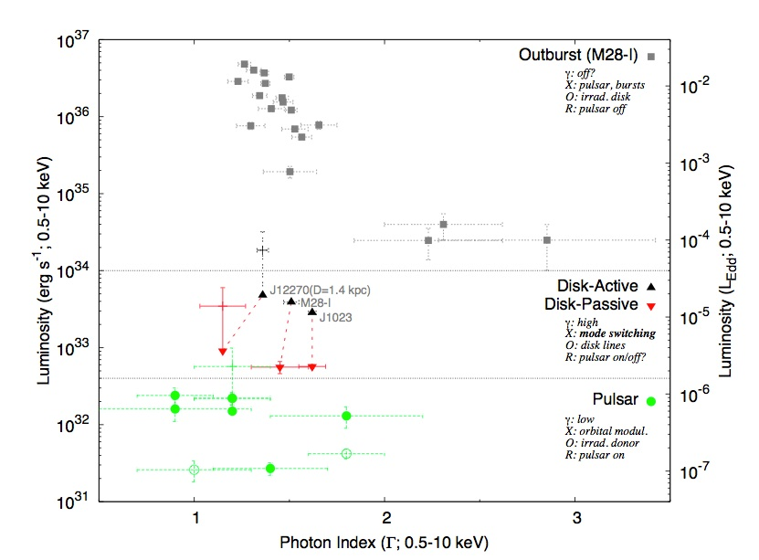
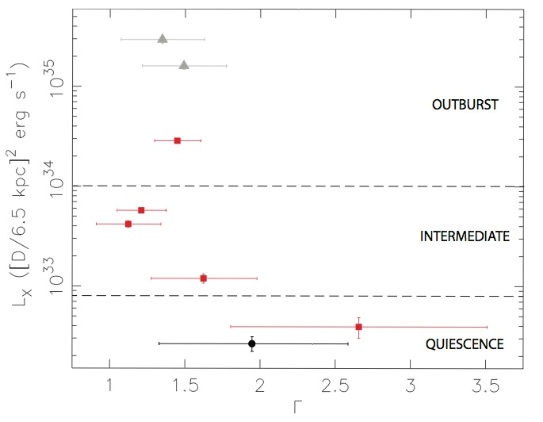
Could it be similar to the transitional pulsars?
XMM J174457-2850.3
Degenaar et al. 2014
Linares 2014

Slide 25
Quiescence variability
Normal NS-LMXBs tMSPs
Cen X-4 Cackett et al. 2010
M28I Linares et al. 2014
Terzan 5 X-1 Degenaar & Wijnands 2012
PSR J1023+0038 Bogdanov et al. 2015
Effect of the presence of a magnetic field?

Slide 26
Conclusion
A lot of weird stuff at very low accretion rate
  Difficult to study and get high quality data
    But making progress!
    Sensitive all-sky monitors
Difficult to interpret due to lack of data
  But neutron star seems to become a very important player
  Unclear if one or multiple mechanisms produce the observed power-law component
Also other NS LMXBs might have odd accretion modes
  Connection with the ‘transition pulsars’?
  So also compare the ‘transition pulsars’ with ‘normal’ LMXBs

